Slide 1
Cryptanalysis
Elliptic Curves
John Manferdelli
JohnManferdelli@hotmail.com
© 2004-2025, John L. Manferdelli.
This material is provided without warranty of any kind including, without limitation, warranty of non-infringement or suitability for any purpose. This material is not guaranteed to be error free and is intended for instructional use only.

Slide 2
Elliptic Curves
Motivation:
Full employment act for mathematicians
Elliptic curves over finite fields have an arithmetic operation
Index calculus doesn’t work on elliptic curves.
Even for large elliptic curves, field size is relatively modest so arithmetic is faster
.
Use this operation to define a discrete log problem.
To do this we need to:
Define point addition and multiplication on an elliptic curve
Find an elliptic curve whose arithmetic gives rise to large finite groups with elements of high order
Figure out how to embed a message in a point multiplication.
Figure out how to pick “good” curves.

Slide 3
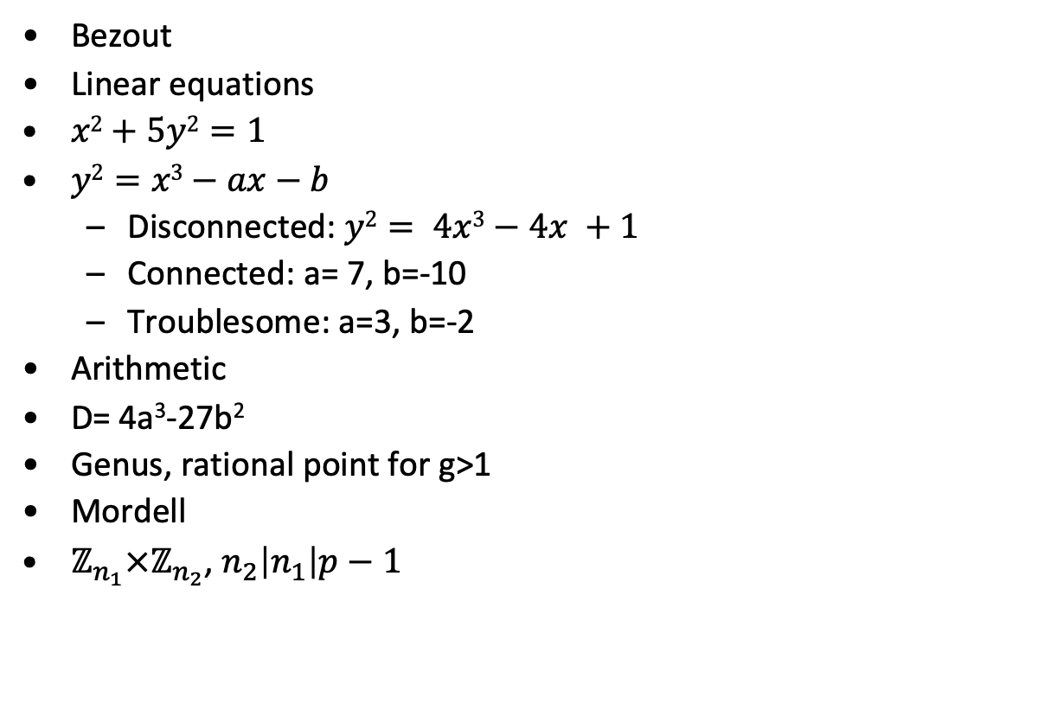
Rational Points
Bezout
Linear equations
$x2+5y2=1$
$y2=x3−ax−b$
Disconnected: $y2= 4x3−4x +1$
Connected: a= 7, b=-10
Troublesome: a=3, b=-2
Arithmetic
D= 4a³-27b²
Genus, rational point for g>1
Mordell
$ℤ_{n_{1}}×ℤ_{n_{2}}$,${ n}_{2}\left|n_{1}\right|p−1$

Slide 4
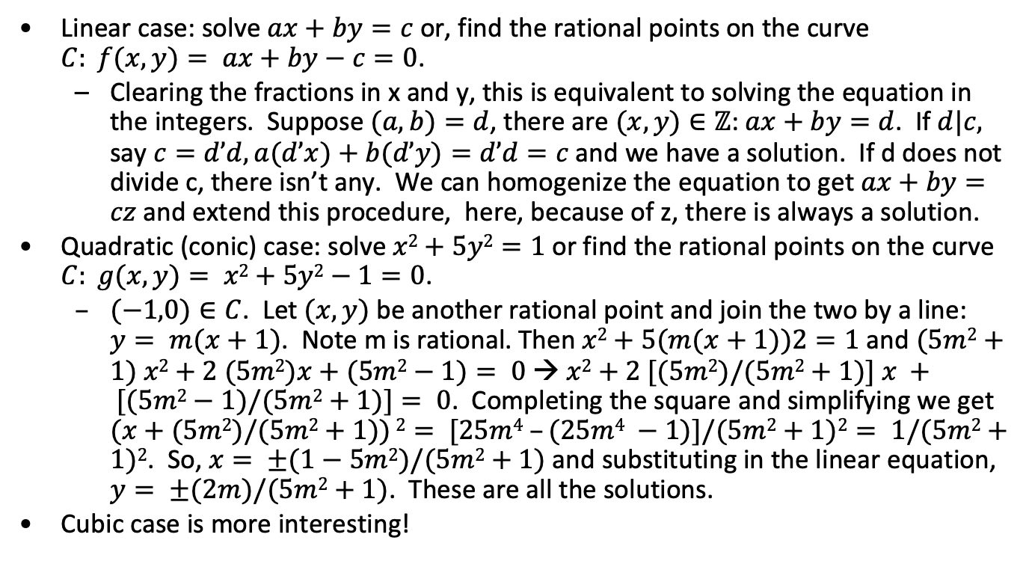
Equation solving in the rational numbers
Linear case: solve $ax+by=c$or, find the rational points on the curve $C: f(x,y)= ax+by−c=0$.
Clearing the fractions in x and y, this is equivalent to solving the equation in the integers. Suppose $(a,b)=d$, there are $(x,y)∈ℤ$:$ax+by=d$. If $d|c,$ say $c=d’d, a(d’x)+b(d’y)=d’d=c$and we have a solution. If d does not divide c, there isn’t any. We can homogenize the equation to get $ax+by=cz$and extend this procedure, here, because of z, there is always a solution.
Quadratic (conic) case: solve $x2+5y2=1$ or find the rational points on the curve $C: g(x,y)= x2+5y2−1=0$.
$(−1,0)∈C$. Let $(x,y)$be another rational point and join the two by a line: $y= m(x+1)$. Note m is rational. Then $x2+5(m(x+1))2=1$ and $(5m2+1) x2+2 (5m2)x+(5m2−1)= 0 → x2+2 [(5m2)/(5m2+1)] x + [(5m2−1)/(5m2+1)]= 0$. Completing the square and simplifying we get $(x+(5m2)/(5m2+1)) 2= [25m4 –(25m4 −1)]/(5m2+1)2= 1/(5m2+1)2$. So, $x= ±(1−5m2)/(5m2+1)$ and substituting in the linear equation, $y= ±(2m)/(5m2+1)$. These are all the solutions.
Cubic case is more interesting!

Slide 5
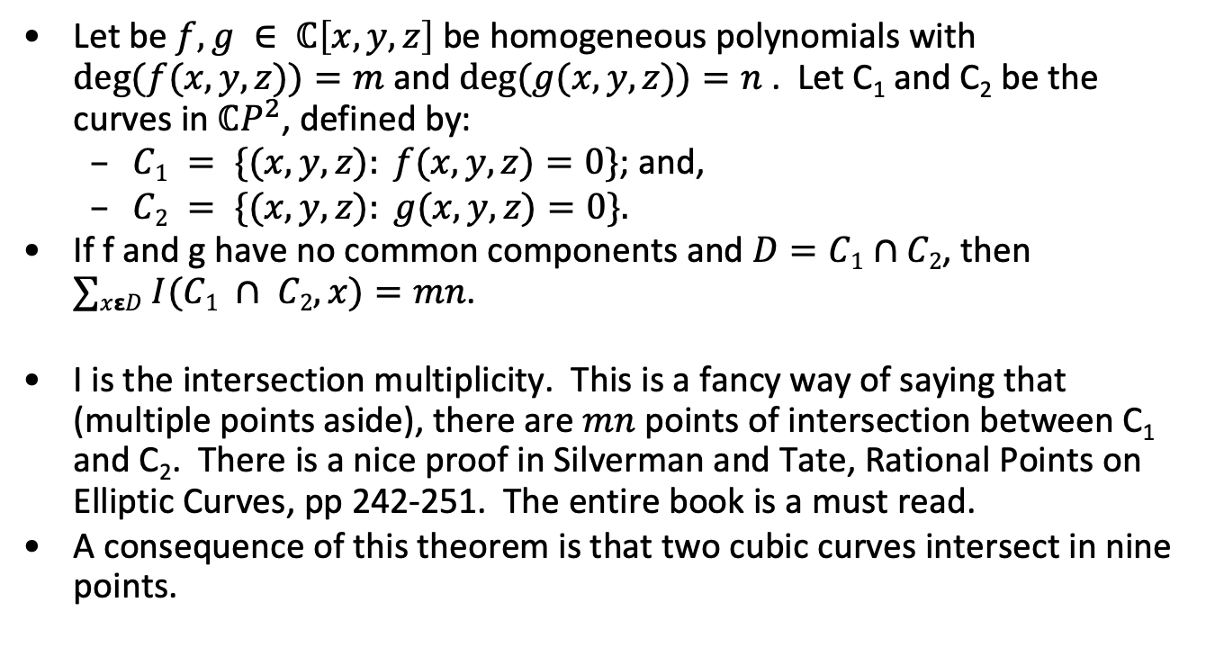
Bezout’s Theorem
Let be $f,g ∈ ℂ\left[x,y,z\right]$ be homogeneous polynomials with $deg⁡(f(x,y,z))=m$and $deg⁡(g(x,y,z))=n$. Let C₁ and C₂ be the curves in${ ℂP}^{2}$, defined by:
$C1 = \{(x,y,z): f(x,y,z)=0\}$; and,
$C2 = \{(x,y,z): g(x,y,z)=0\}.$
If f and g have no common components and $D=C1∩C2$, then $∑xεD I(C1 ∩ C2,x)=mn$.
I is the intersection multiplicity. This is a fancy way of saying that (multiple points aside), there are $mn$ points of intersection between C₁ and C₂. There is a nice proof in Silverman and Tate, Rational Points on Elliptic Curves, pp 242-251. The entire book is a must read.
A consequence of this theorem is that two cubic curves intersect in nine points.

Slide 6
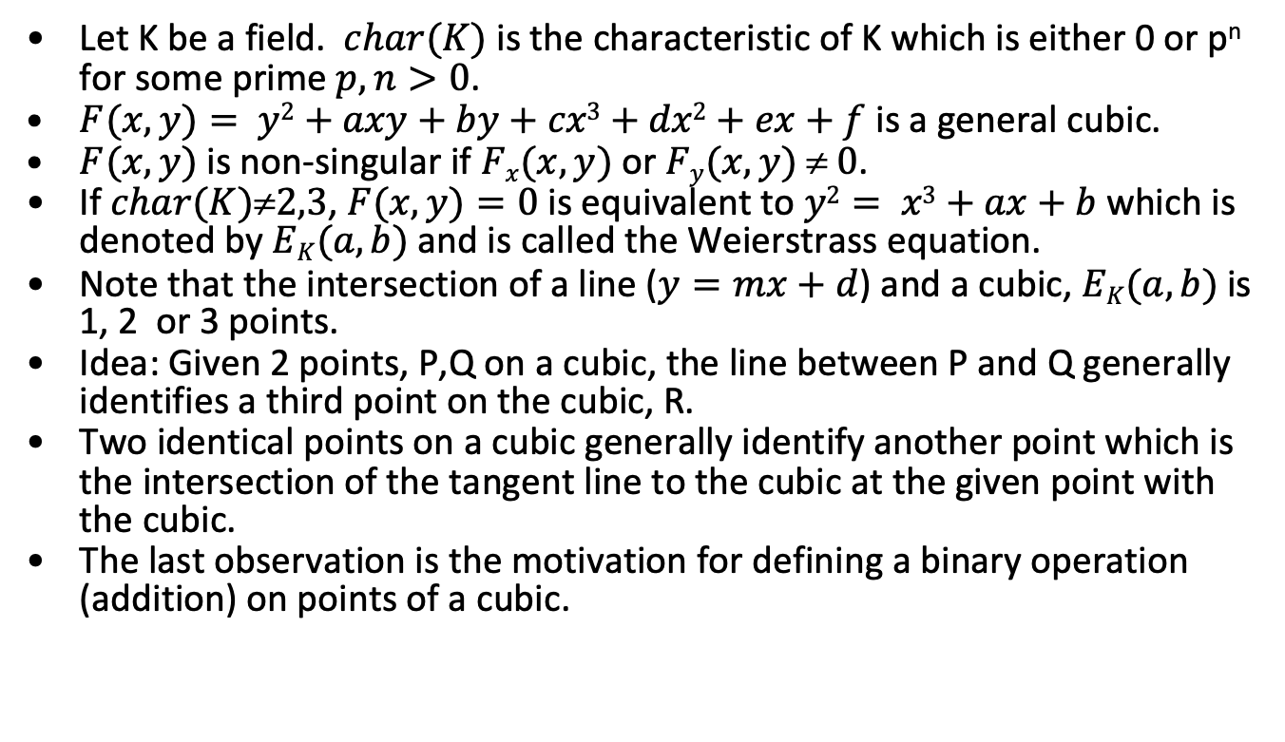
Elliptic Curve Preliminaries -1
Let K be a field. $char(K)$ is the characteristic of K which is either 0 or p^{n} for some prime $p, n>0$.
$F(x,y)= y2+axy+by+cx3+dx2+ex+f$ is a general cubic.
$F(x,y)$is non-singular if $Fx(x,y)$or $Fy(x,y)  0$.
If $char(K)2,3$, $F(x,y)=0$is equivalent to $y2= x3+ax+b$which is denoted by $EK(a, b)$and is called the Weierstrass equation.
Note that the intersection of a line ($y=mx+d$) and a cubic, $EK(a,b)$is 1, 2 or 3 points.
Idea: Given 2 points, P,Q on a cubic, the line between P and Q generally identifies a third point on the cubic, R.
Two identical points on a cubic generally identify another point which is the intersection of the tangent line to the cubic at the given point with the cubic.
The last observation is the motivation for defining a binary operation (addition) on points of a cubic.

Slide 7
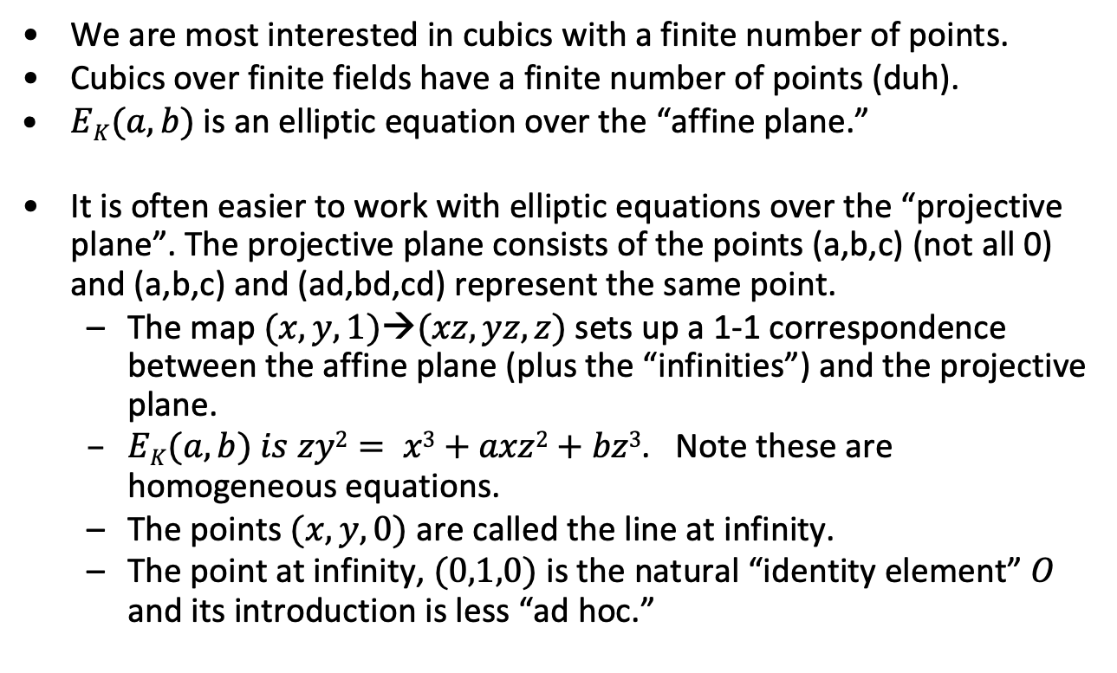
Elliptic Curve Preliminaries - 2
We are most interested in cubics with a finite number of points.
Cubics over finite fields have a finite number of points (duh).
$EK(a,b)$is an elliptic equation over the “affine plane.”
It is often easier to work with elliptic equations over the “projective plane”. The projective plane consists of the points (a,b,c) (not all 0) and (a,b,c) and (ad,bd,cd) represent the same point.
The map$(x,y,1)→(xz,yz,z)$sets up a 1-1 correspondence between the affine plane (plus the “infinities”) and the projective plane.
$EK(a,b) is zy2= x3+axz2+bz3$. Note these are homogeneous equations.
The points $(x,y,0)$ are called the line at infinity.
The point at infinity, $(0,1,0)$ is the natural “identity element” $O$ and its introduction is less “ad hoc.”

Slide 8
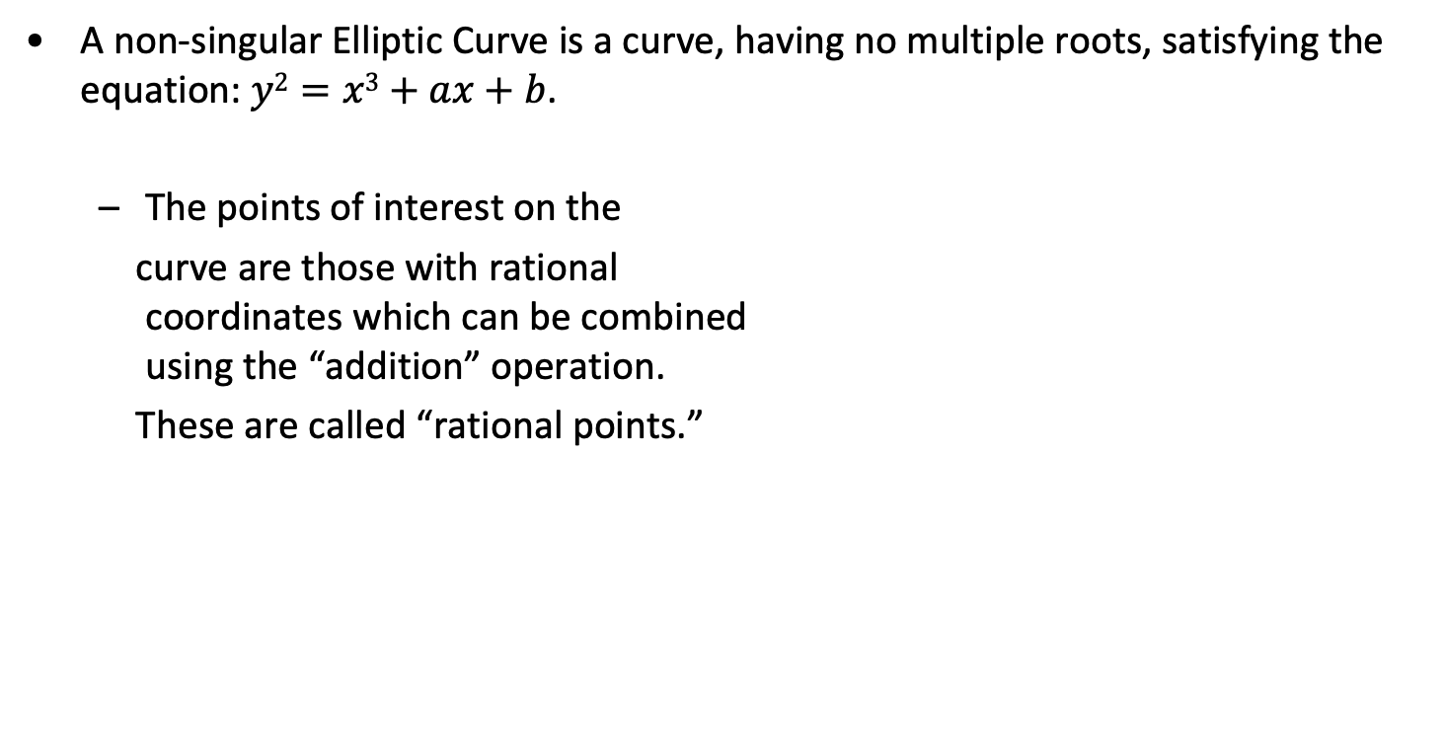
Elliptic Curves
A non-singular Elliptic Curve is a curve, having no multiple roots, satisfying the equation: $y2=x3+ax+b$.
The points of interest on the
curve are those with rational coordinates which can be combined using the “addition” operation.
These are called “rational points.”
Graphic by Richard Spillman

Slide 9
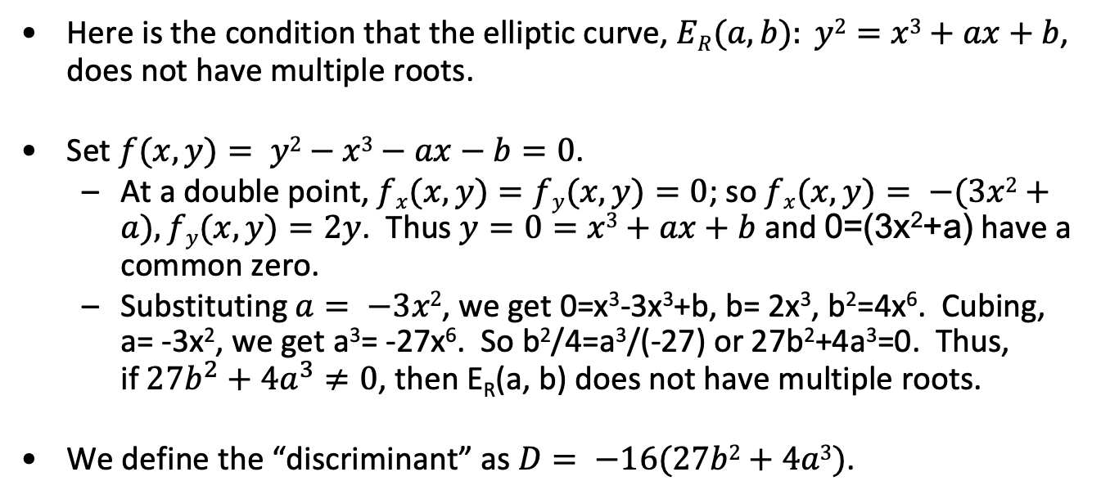
Multiple roots
Here is the condition that the elliptic curve, $ER(a, b): y2=x3+ax+b$, does not have multiple roots.
Set $f(x,y)= y2−x3−ax−b=0$.
At a double point, $fx(x,y)=fy(x,y)=0$; so $fx(x,y)= −(3x2+a), fy(x,y)=2y$. Thus $y=0=x3+ax+b$ and 0=(3x²+a) have a common zero.
Substituting $a= −3x2$, we get 0=x³-3x³+b, b= 2x³, b²=4x⁶. Cubing, a= -3x², we get a³= -27x⁶. So b²/4=a³/(-27) or 27b²+4a³=0. Thus, if$27b^{2}+4a^{3}≠0$, then E_{R}(a, b) does not have multiple roots.
We define the “discriminant” as $D= −16(27b2+4a3)$.

Slide 10
Elliptic curve addition
The addition operator on a non-singular elliptic curve maps two points, P and Q, into a third “P+Q”. Here’s how we construct “P+Q” when P≠Q .
Construct straight line through P and Q which hits E at R.
P+Q is the point which is the reflection of R across the x-axis.
R
Q
P
P+Q
Graphic by Richard Spillman

Slide 11
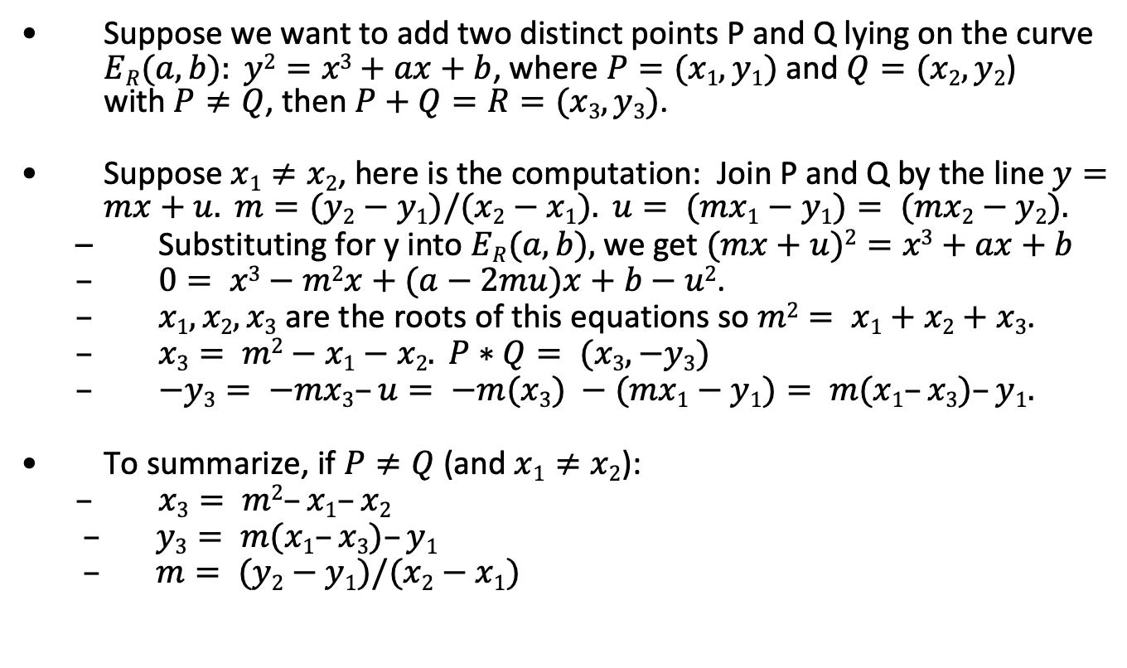
Addition for points P, Q in E_{R}(a, b) - 1
Suppose we want to add two distinct points P and Q lying on the curve $ER(a, b): y2=x3+ax+b$, where $P=(x1, y1)$and $Q=(x2, y2$) with$P≠Q$, then $P+Q=R=(x3, y3)$.
Suppose $x1≠x2$, here is the computation: Join P and Q by the line $y=mx+u. m=(y2−y1)/(x2−x1). u= (mx1−y1)= (mx2−y2).$
Substituting for y into $ER(a, b),$we get $(mx+u)2=x3+ax+b$
$0= x3−m2x+(a−2mu)x+b−u2$.
$x1, x2, x3$ are the roots of this equations so $m2= x1+x2+x3$.
$x3= m2−x1−x2. P∗Q= (x3, −y3)$
$−y3= −mx3–u= −m(x3) −(mx1−y1)= m(x1–x3)–y1.$
To summarize, if $P≠Q$ (and $x1≠x2$):
$x3= m2–x1–x2$
$y3= m(x1–x3)–y1$
$m= (y2−y1)/(x2−x1)$

Slide 12
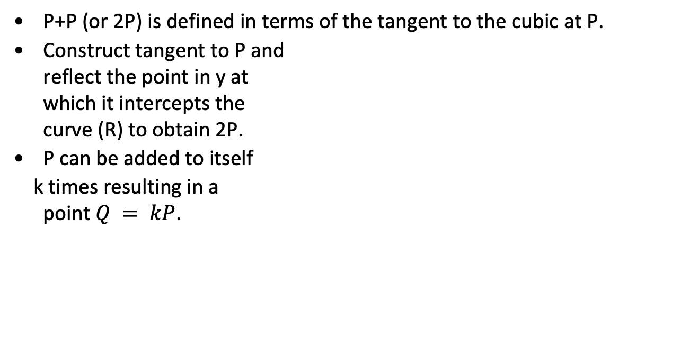
Multiples in Elliptic Curves 1
P+P (or 2P) is defined in terms of the tangent to the cubic at P.
Construct tangent to P and reflect the point in y at which it intercepts the curve (R) to obtain 2P.
P can be added to itself
k times resulting in a point $Q = kP$.
P+P= 2P
P
R
Graphic by Richard Spillman

Slide 13
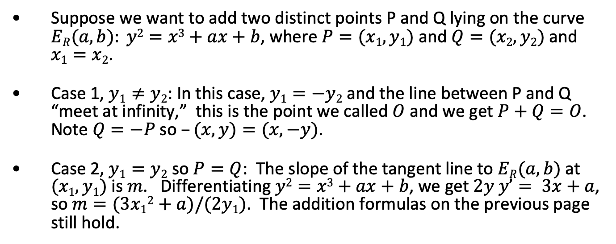
Addition for points P, Q in E_{R}(a, b) - 2
Suppose we want to add two distinct points P and Q lying on the curve $ER(a, b): y2=x3+ax+b$, where $P=(x1, y1)$and $Q=(x2, y2)$ and $x1=x2$.
Case 1, $y1≠y2$: In this case, $y1=−y2$and the line between P and Q “meet at infinity,” this is the point we called $O$ and we get $P+Q=O$. Note $Q=−P$so $–(x,y)=(x,−y)$.
Case 2, $y1=y2$ so $P=Q$: The slope of the tangent line to $ER(a, b)$ at $(x1, y1)$ is $m$. Differentiating $y2=x3+ax+b$, we get $2y y’= 3x+a$, so $m=(3x12+a)/(2y1)$. The addition formulas on the previous page still hold.

Slide 14
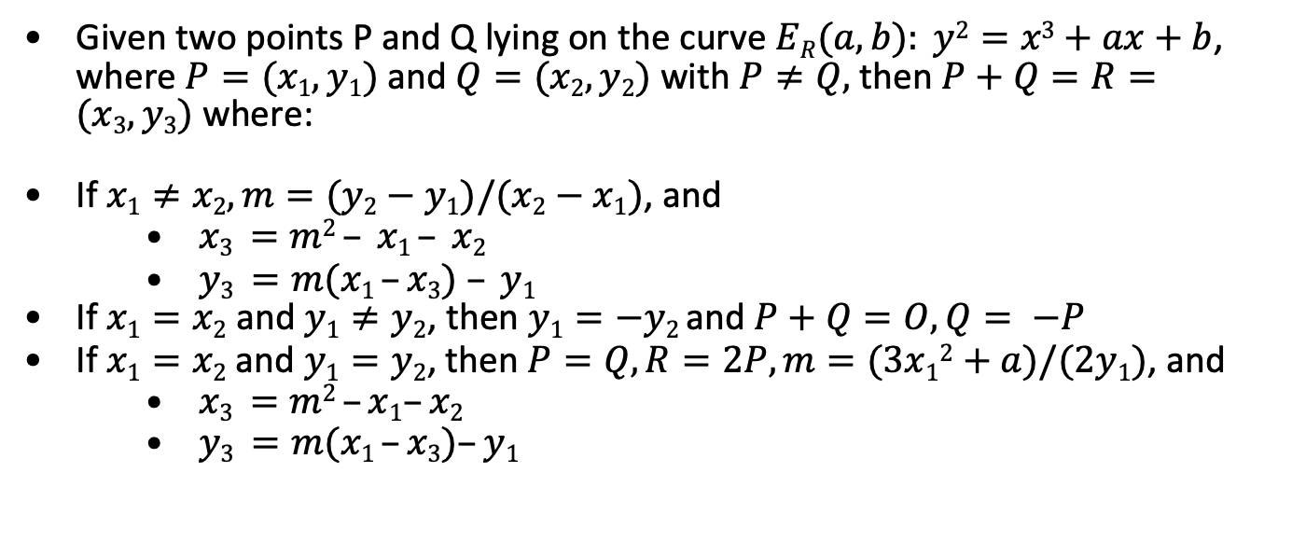

Addition in $ER(a, b)$ - summary
Given two points P and Q lying on the curve $ER(a, b): y2=x3+ax+b$, where $P=(x1, y1)$ and $Q=(x2, y2)$ with $P≠Q,$ then $P+Q=R=(x3, y3)$ where:
If $x1≠x2, m=(y2−y1)/(x2−x1)$, and
$x3 =m2 – x1 – x2$
$y3 =m(x1 –x3) – y1$
If $x1=x2$ and $y1≠y2$, then $y1=−y2$and $P+Q=O, Q= −P$
If $x1=x2$and $y1=y2$, then $P=Q, R=2P, m=(3x12+a)/(2y1)$, and
$x3 =m2 –x1–x2$
$y3 =m(x1 –x3)–y1$

Slide 15
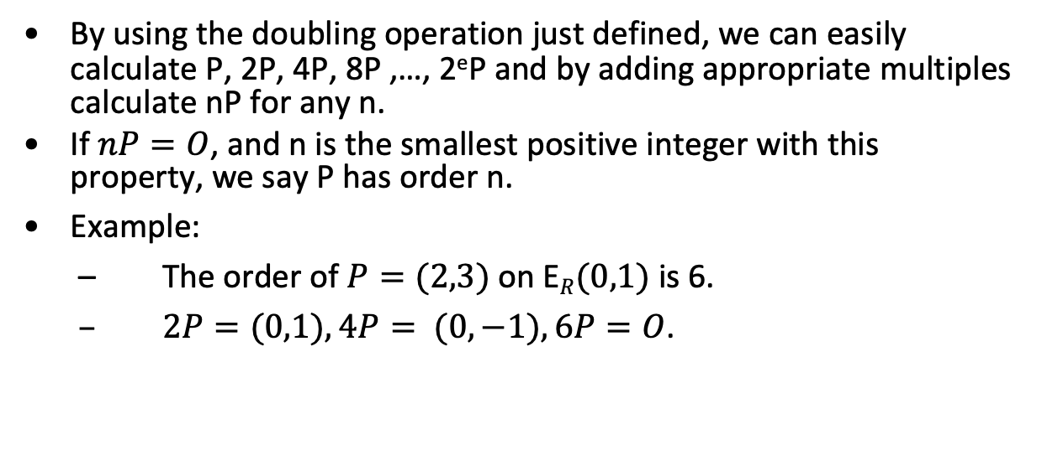
Point multiplication in E_{R}(a, b)
By using the doubling operation just defined, we can easily calculate P, 2P, 4P, 8P ,…, 2eP and by adding appropriate multiples calculate nP for any n.
If $nP=O$, and n is the smallest positive integer with this property, we say P has order n.
Example:
The order of $P=(2,3)$on E$R(0,1)$is 6.
$2P=(0,1), 4P= (0,−1), 6P=O$.

Slide 16
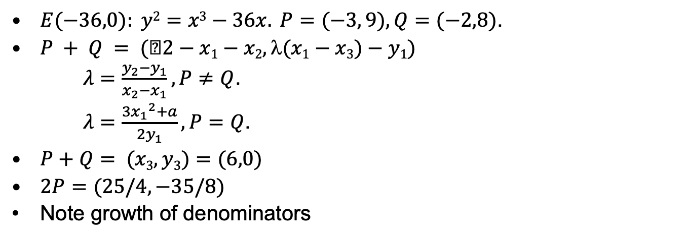
Example of Addition and Element Order
$E(−36,0): y2=x3−36x. P=(−3, 9), Q=(−2,8)$.
$P + Q = (2−x1−x2, (x1−x3)−y1)$
$λ=\frac{y_{2}−y_{1}}{x_{2}−x_{1}}, P≠Q$.
$λ=\frac{3{x_{1}}^{2}+a}{{2y}_{1}}, P=Q$.
$P+Q= (x3,y3)=(6,0)$
$2P=(25/4,−35/8)$
Note growth of denominators

Slide 17
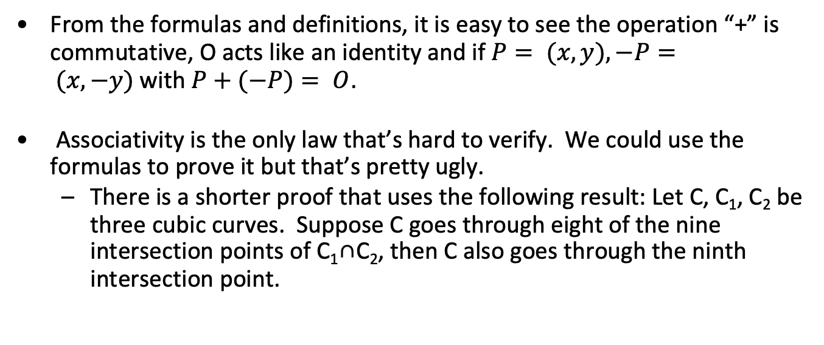
Proof of group laws
From the formulas and definitions, it is easy to see the operation “+” is commutative, O acts like an identity and if $P= (x,y), −P= (x,−y)$with $P+(−P)= O$.
Associativity is the only law that’s hard to verify. We could use the formulas to prove it but that’s pretty ugly.
There is a shorter proof that uses the following result: Let C, C₁, C₂ be three cubic curves. Suppose C goes through eight of the nine intersection points of C₁∩C₂, then C also goes through the ninth intersection point.

Slide 18
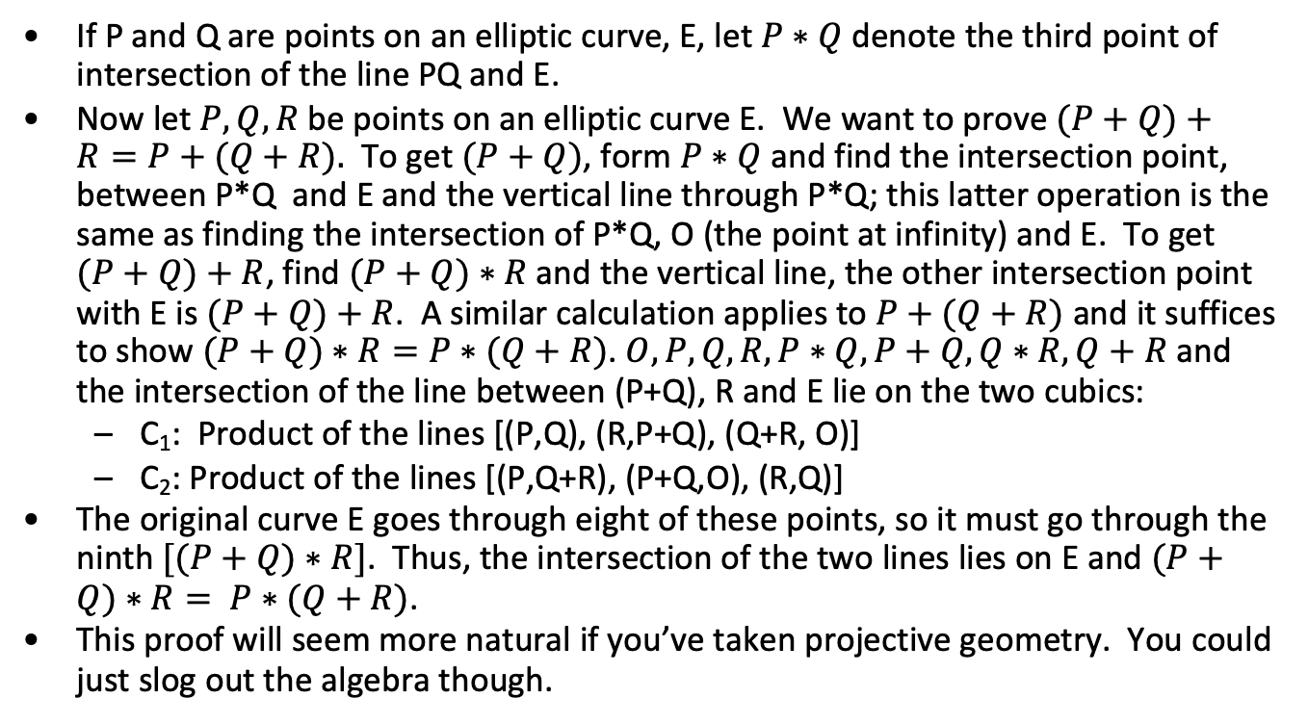
Associativity
If P and Q are points on an elliptic curve, E, let $P∗Q$ denote the third point of intersection of the line PQ and E.
Now let $P, Q, R$be points on an elliptic curve E. We want to prove $(P+Q)+R=P+(Q+R).$ To get $(P+Q)$, form $P∗Q$ and find the intersection point, between P*Q and E and the vertical line through P*Q; this latter operation is the same as finding the intersection of P*Q, O (the point at infinity) and E. To get $(P+Q)+R$, find $(P+Q)∗R$and the vertical line, the other intersection point with E is $(P+Q)+R$. A similar calculation applies to $P+(Q+R)$ and it suffices to show $(P+Q)∗R=P∗(Q+R)$. $O,P,Q,R, P∗Q, P+Q, Q∗R, Q+R$ and the intersection of the line between (P+Q), R and E lie on the two cubics:
C₁: Product of the lines [(P,Q), (R,P+Q), (Q+R, O)]
C₂: Product of the lines [(P,Q+R), (P+Q,O), (R,Q)]
The original curve E goes through eight of these points, so it must go through the ninth $[(P+Q)∗R]$. Thus, the intersection of the two lines lies on E and $(P+Q)∗R= P∗(Q+R)$.
This proof will seem more natural if you’ve taken projective geometry. You could just slog out the algebra though.

Slide 19
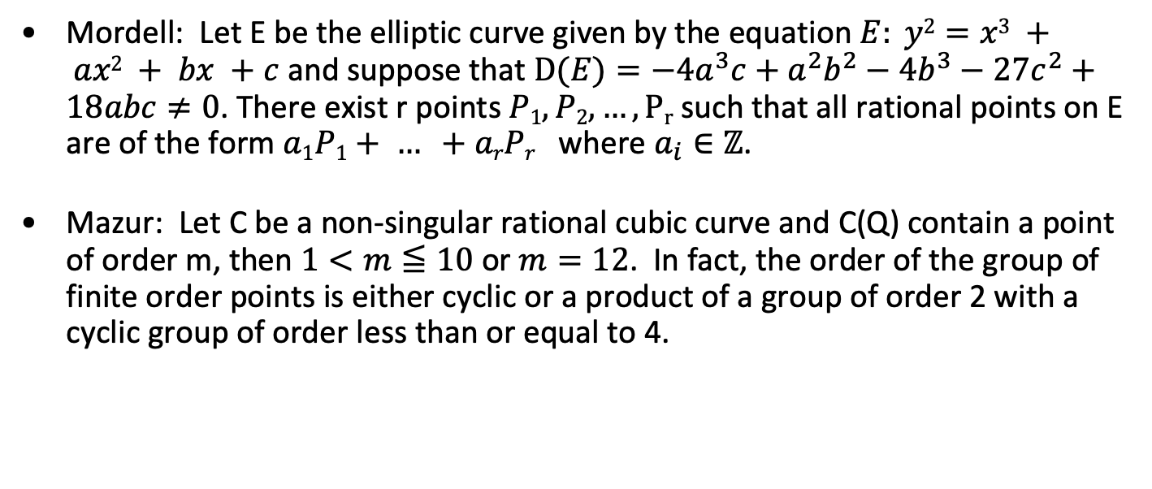
Mordell and Mazur
Mordell: Let E be the elliptic curve given by the equation $E: y2=x3 + ax2 + bx +c$ and suppose that $D(E)=−4a^{3}c+a^{2}b^{2}−4b^{3}−27c^{2}+18abc≠0$. There exist r points $P1, P2, …, Pr⁡$such that all rational points on E are of the form $a1P1+ … +arPr$where $a_{i}∈ℤ$.
Mazur: Let C be a non-singular rational cubic curve and C(Q) contain a point of order m, then $1<m≦10$or $m=12$. In fact, the order of the group of finite order points is either cyclic or a product of a group of order 2 with a cyclic group of order less than or equal to 4.

Slide 20
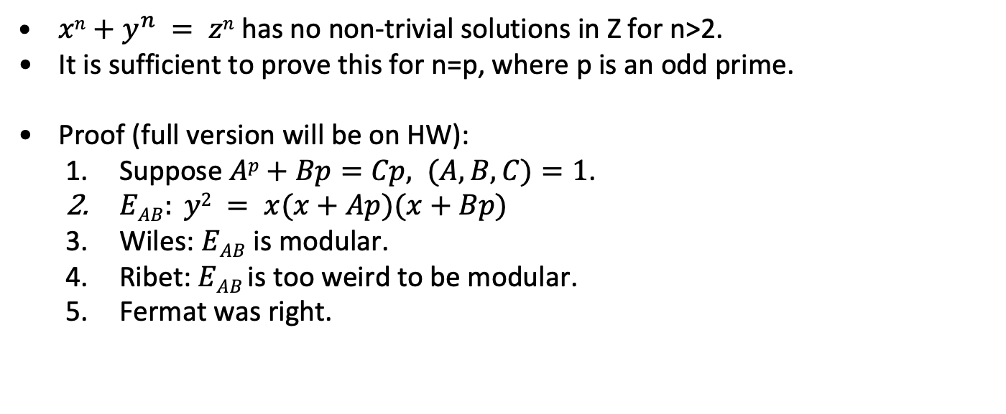
Fermat’s Last Theorem
$xn+y^{n} = zn$has no non-trivial solutions in Z for n>2.
It is sufficient to prove this for n=p, where p is an odd prime.
Proof (full version will be on HW):
Suppose $Ap+Bp=Cp, (A,B,C)=1$.
$EAB: y2 = x(x+Ap)(x+Bp)$
Wiles: $EAB$ is modular.
Ribet: $EAB$is too weird to be modular.
Fermat was right.

Slide 21
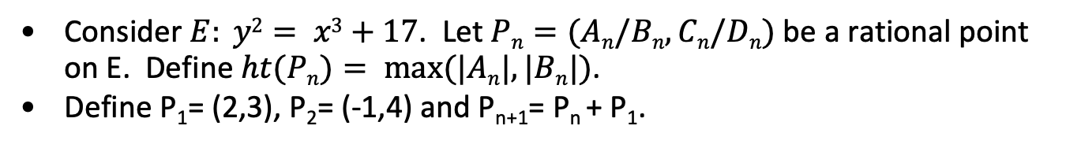
Why elliptic curves might be valuable in crypto
Consider $E: y2= x3+17$. Let $Pn=(An/Bn, Cn/Dn)$be a rational point on E. Define $ht(Pn)= max⁡(|An|, |Bn|)$.
Define P₁= (2,3), P₂= (-1,4) and P_{n+1}= P_{n} + P₁.
n | ht(P_{n})
1 | 2
2 | 1
3 | 4
4 | 2
5 | 4
6 | 106
7 | 2228
n | ht(P_{n})
8 | 76271
9 | 9776276
10 | 3497742218
20 | 8309471981636130322638066614339972215969861310
In fact, ht(P_{n})≅(1.574)^{ns}, ns=n².
Example from Silverman, A Friendly Introduction to Number Theory.

Slide 22
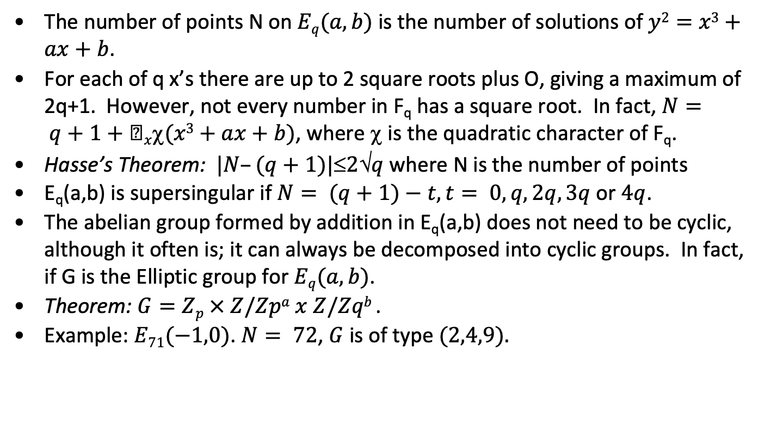
Points on elliptic curves over F_{q}
The number of points N on $Eq(a,b)$ is the number of solutions of $y2=x3+ax+b$.
For each of q x’s there are up to 2 square roots plus O, giving a maximum of 2q+1. However, not every number in F_{q} has a square root. In fact, $N= q+1+x(x3+ax+b)$, where χ is the quadratic character of F_{q}.
Hasse’s Theorem: $|N–(q+1)|2q$ where N is the number of points
E_{q}(a,b) is supersingular if $N= (q+1)−t, t= 0,q, 2q, 3q$ or $4q$.
The abelian group formed by addition in E_{q}(a,b) does not need to be cyclic, although it often is; it can always be decomposed into cyclic groups. In fact, if G is the Elliptic group for $Eq(a,b)$.
Theorem: $G=Zp × Z/Zpa x Z/Zqb$.
Example: $E71(−1,0)$. $N= 72$, $G$ is of type $(2,4,9).$

Slide 23
E₇₁(-1, 0) – Spot the Group
There are 72 points on the curve. Can you spot (2, 4, 9). Points:
Order Point
[ 1] O
[ 2] ( 0, 0)
[ 2] ( 1, 0)
[ 9] ( 2, 19)
[ 9] ( 2, 52)
[ 18] ( 3, 38)
[ 18] ( 3, 33)
[ 9] ( 4, 42)
[ 9] ( 4, 29)
[ 18] ( 5, 7)
[ 18] ( 5, 64)
[ 6] ( 9, 62)
[ 6] ( 9, 9)
[ 36] (12, 56)
[ 36] (12, 15)
[ 4] (13, 14)
[ 4] (13, 57)
[ 18] (14, 23)
Order Point
[ 18] (14, 48)
[ 3] (19, 38)
[ 3] (19, 33)
[ 36] (21, 62)
[ 36] (21, 9)
[ 18] (23, 28)
[ 18] (23, 43)
[ 36] (27, 42)
[ 36] (27, 29)
[ 12] (32, 54)
[ 12] (32, 17)
[ 36] (33, 7)
[ 36] (33, 64)
[ 18] (35, 58)
[ 18] (35, 13)
[ 9] (37, 8)
[ 9] (37, 63)
[ 12] (40, 42)
Order Point
[ 12] (40, 29)
[ 36] (41, 62)
[ 36] (41, 9)
[ 18] (42, 8)
[ 18] (42, 63)
[ 36] (43, 21)
[ 36] (43, 50)
[ 36] (45, 49)
[ 36] (45, 22)
[ 36] (46, 37)
[ 36] (46, 34)
[ 18] (47, 51)
[ 18] (47, 20)
[ 18] (49, 38)
[ 18] (49, 33)
[ 12] (51, 16)
[ 12] (51, 55)
[ 18] (53, 47)
Order Point
[ 18] (53, 24)
[ 36] (54, 28)
[ 36] (54, 43)
[ 12] (55, 31)
[ 12] (55, 40)
[ 6] (56, 41)
[ 6] (56, 30)
[ 4] (60, 10)
[ 4] (60, 61)
[ 36] (61, 2)
[ 36] (61, 69)
[ 6] (63, 8)
[ 6] (63, 63)
[ 36] (64, 27)
[ 36] (64, 44)
[ 36] (65, 28)
[ 36] (65, 43)
[ 2] (70, 0)

Slide 24
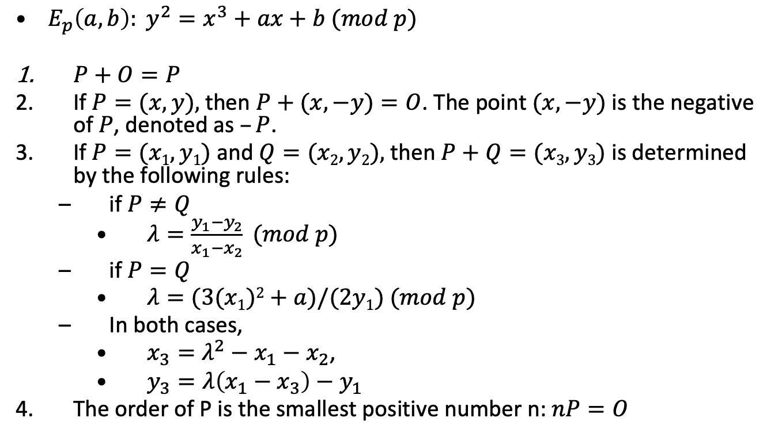
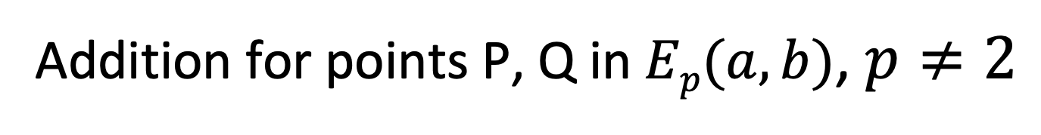
Addition for points P, Q in $Ep(a, b)$, $p≠2$
$E_{p}\left(a,b\right): y^{2}=x^{3}+ax+b (mod p)$
$P+O=P$
If $P=(x, y),$then $P+(x, −y)=O$. The point $(x, −y)$ is the negative of $P$, denoted as $–P$.
If $P=(x1, y1)$ and $Q=(x2, y2),$ then $P+Q=(x3, y3)$ is determined by the following rules:
if $P≠Q$
$λ=\frac{y_{1}−y_{2}}{x_{1}−x_{2}} (mod p)$
if $P=Q$
$λ=(3(x1)2+a)/(2y1) (mod p)$
In both cases,
$x_{3}=λ^{2}−x_{1}−x_{2}$,
$y_{3}=λ\left(x_{1}−x_{3}\right)−y_{1}$
The order of P is the smallest positive number n: $nP=O$

Slide 25
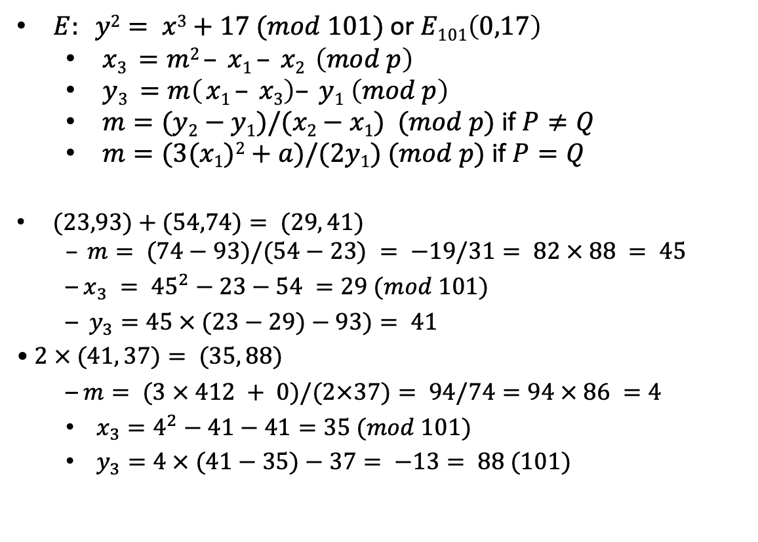

Point multiplication in $Ep(a, b)$
$E: y2= x3+17 (mod 101)$ or $E101\left(0,17\right)$
$x3 =m2 – x1 – x2 \left(mod p\right)$
$y3 =m\left( x1 – x3\right)– y1 \left(mod p\right)$
$m=(y2−y1)/(x2−x1) (mod p)$if $P≠Q$
$m=(3(x1)2+a)/(2y1) (mod p)$if $P=Q$
– $x_{3} = {45}^{2}−23−54 =29 (mod 101)$
– $y_{3}=45 × (23−29)−93)= 41$
• $2 × (41, 37)= (35, 88)$
– $m= (3 × 412 + 0)/(2×37)= 94/74=94 × 86 =4$
$x_{3}=4^{2}−41−41=35 (mod 101)$
$y_{3}=4 × (41−35)−37= −13= 88 (101)$
Note:
93²= 23³+17=64 (101)
74²= 54³+17=22 (101)
41²= 29³+17=65 (101)
37²= 41³+17=56 (101)
88²= 35³+17=64 (101)

Slide 26
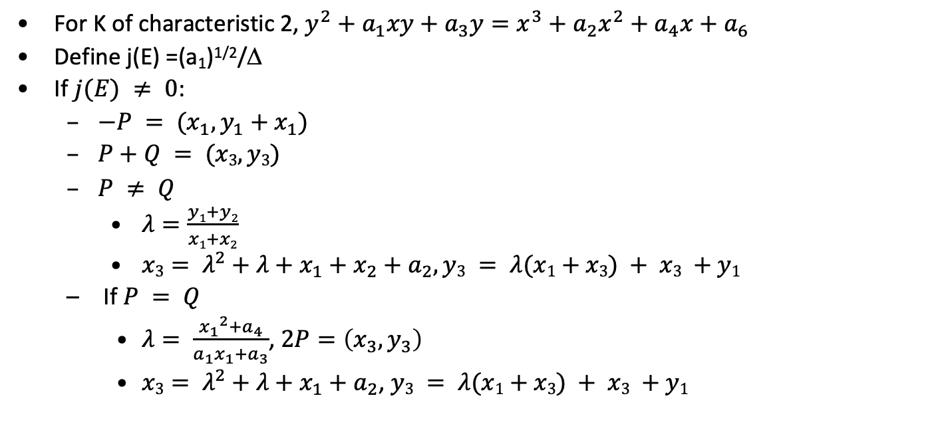
Elliptic Curve (Characteristic = 2)
For K of characteristic 2, $y^{2}+a_{1}xy+a_{3}y=x^{3}+a_{2}x^{2}+a_{4}x+a_{6}$
Define j(E) =(a₁)^{1/2}/Δ
If $j(E) ≠ 0$:
$λ=\frac{y1+y2}{x1+x2}$
$x3= λ^{2}+λ+x_{1}+x_{2}+a_{2}, y3 = λ(x1+x3) + x3 +y1$
If $P = Q$
$λ= \frac{{x_{1}}^{2}+a_{4}}{a_{1}x_{1}+a_{3}}$, $2P=\left(x_{3},y_{3}\right)$
$x3= λ^{2}+λ+x_{1}+a_{2}$, $y3 = λ(x1+x3) + x3 +y1$

Slide 27
Structure of the Elliptic Curve Group on E_{p}(a,b) - 1
E₁₁(1, 6)[ y²= x³ + 1 x + 6 (mod 11)]. D: -7, 2 is primitive (mod 11). D=4a³+27b² (mod p). 13 points on curve; G, cyclic.
Order Point
[ 1] O
[13] ( 2, 4)
[13] ( 2, 7)
[13] ( 3, 5)
[13] ( 3, 6)
[13] ( 5, 2)
[13] ( 5, 9)
[13] ( 7, 2)
[13] ( 7, 9)
[13] ( 8, 8)
[13] ( 8, 3)
[13] (10, 2)
[13] (10, 9)
Powers
( 1) ( 5, 2)
( 2) (10, -9)
( 3) ( 7, 9)
( 4) ( 3, 5)
( 5) ( 8, 8)
( 6) ( 2, 4)
( 7) ( 2, 7)
( 8) ( 8, 3)
( 9) ( 3, 6)
(10) ( 7, 2)
(11) (10, 9)
(12) ( 5, 9)
(13) O

Slide 28
Structure of the Elliptic Curve Group on E_{p}(a,b) - 2
E₃₁(1, 6). D: -23, 3 is primitive (31). 32 points on curve. Not cyclic!
Order Point Order Point
[ 1] O
[16] ( 1, 16)
[16] ( 1, 15)
[ 8] ( 2, 27)
[ 8] ( 2, 4)
[ 4] ( 3, 25)
[ 4] ( 3, 6)
[ 2] ( 9, 0)
[16] (12, 17)
[16] (12, 14)
[ 8] (14, 25)
[ 8] (14, 6)
[16] (17, 10)
[16] (17, 21)
[16] (18, 20)
[16] (18, 11)
[16] (19, 8)
[16] (19, 23)
[ 4] (20, 20)
[ 4] (20, 11)
[16] (21, 9)
[16] (21, 22)
[16] (24, 20)
[16] (24, 11)
[16] (25, 30)
[16] (25, 1)
[ 2] (26, 0)
[ 2] (27, 0)
[ 8] (28, 10)
[ 8] (28, 21)
[ 8] (30, 29)
[ 8] (30, 2)

Slide 29
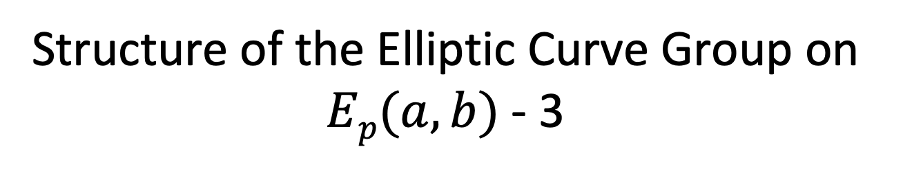
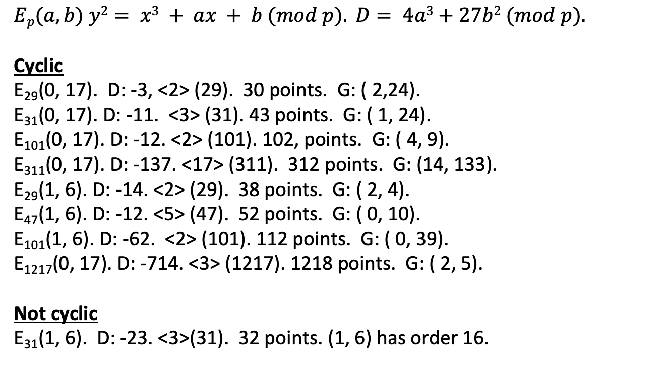
Structure of the Elliptic Curve Group on $Ep(a,b)$- 3
$$Ep(a, b) y2= x3 + ax + b (mod p). D= 4a3+27b2 (mod p).$$
Cyclic
E₂₉(0, 17). D: -3, <2> (29). 30 points. G: ( 2,24).
E₃₁(0, 17). D: -11. <3> (31). 43 points. G: ( 1, 24).
E₁₀₁(0, 17). D: -12. <2> (101). 102, points. G: ( 4, 9).
E₃₁₁(0, 17). D: -137. <17> (311). 312 points. G: (14, 133).
E₂₉(1, 6). D: -14. <2> (29). 38 points. G: ( 2, 4).
E₄₇(1, 6). D: -12. <5> (47). 52 points. G: ( 0, 10).
E₁₀₁(1, 6). D: -62. <2> (101). 112 points. G: ( 0, 39).
E₁₂₁₇(0, 17). D: -714. <3> (1217). 1218 points. G: ( 2, 5).
Not cyclic
E₃₁(1, 6). D: -23. <3>(31). 32 points. (1, 6) has order 16.

Slide 30
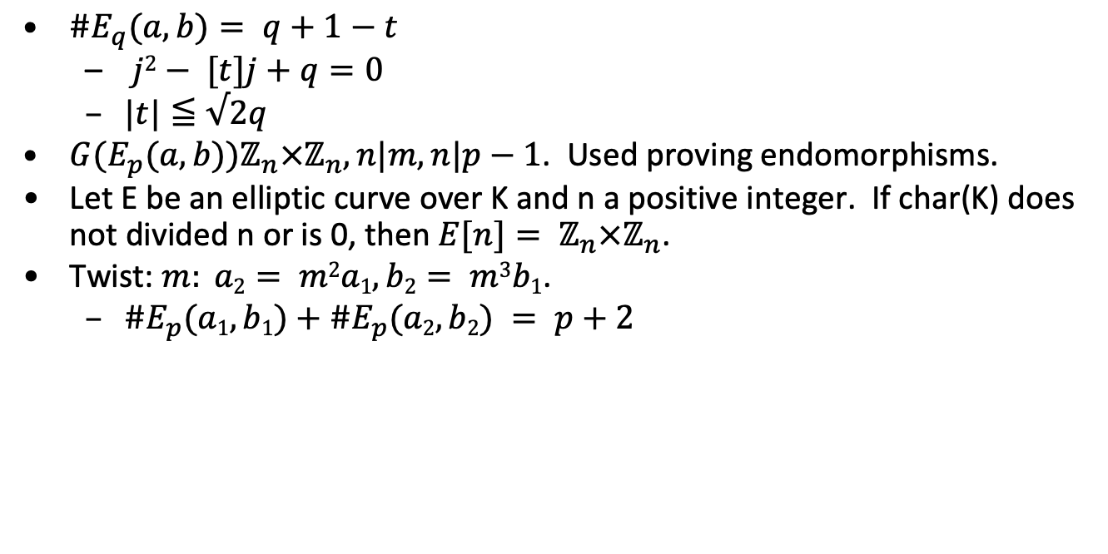
Group order and Hasse
$\#E_{q}(a,b)= q+1−t$
$j2− [t]j+q=0$
$|t|≦√2q$
$G(E_{p}(a,b))ℤ_{n}×ℤ_{n}, n|m, n|p−1$. Used proving endomorphisms.
Let E be an elliptic curve over K and n a positive integer. If char(K) does not divided n or is 0, then $E[n]= ℤ_{n}×ℤ_{n}$.
Twist: $m: a2= m2a1, b2= m3b1$.
$\#E_{p}(a1,b1)+\#E_{p}(a2,b2) = p+2$

Slide 31
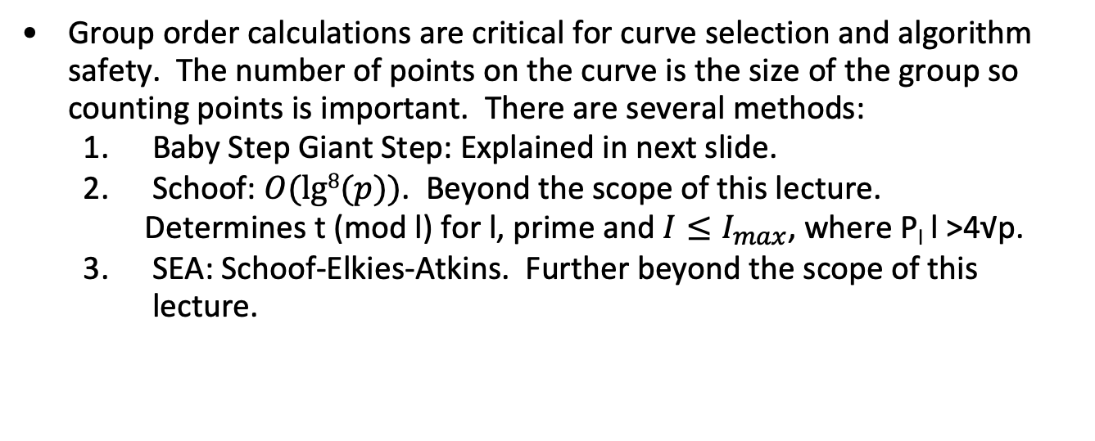
Point counting
Group order calculations are critical for curve selection and algorithm safety. The number of points on the curve is the size of the group so counting points is important. There are several methods:
Baby Step Giant Step: Explained in next slide.
Schoof: $O(lg8(p))$. Beyond the scope of this lecture.
Determines t (mod l) for l, prime and $I≤I_{max}$, where P_{l} l >4√p.
SEA: Schoof-Elkies-Atkins. Further beyond the scope of this lecture.

Slide 32
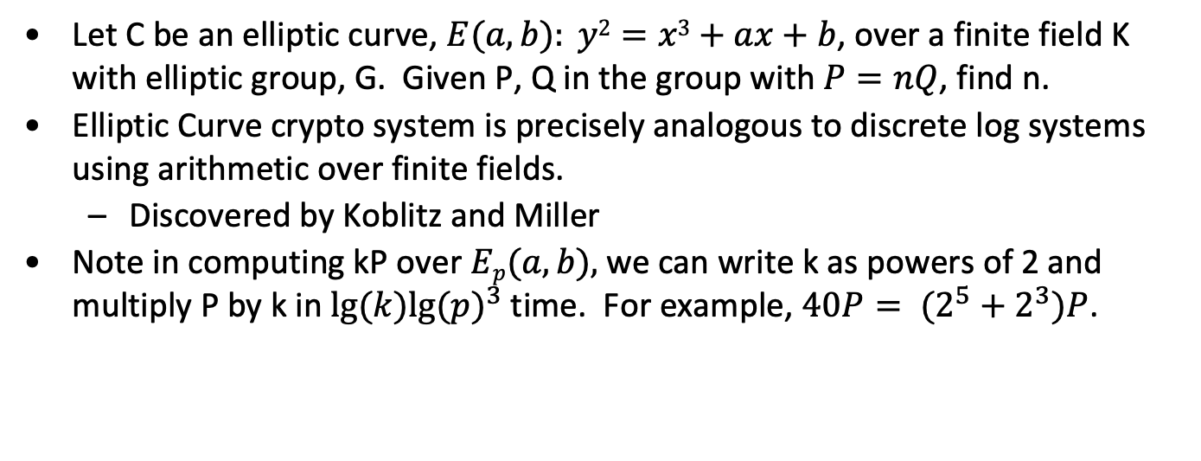
Elliptic Curve Discrete Log Problem
Let C be an elliptic curve, $E(a,b): y2=x3+ax+b$, over a finite field K with elliptic group, G. Given P, Q in the group with $P=nQ$, find n.
Elliptic Curve crypto system is precisely analogous to discrete log systems using arithmetic over finite fields.
Discovered by Koblitz and Miller
Note in computing kP over $Ep(a,b),$we can write k as powers of 2 and multiply P by k in $lg⁡(k){lg⁡(p)}^{3}$time. For example, $40P= (2^{5}+2^{3})P$.

Slide 33
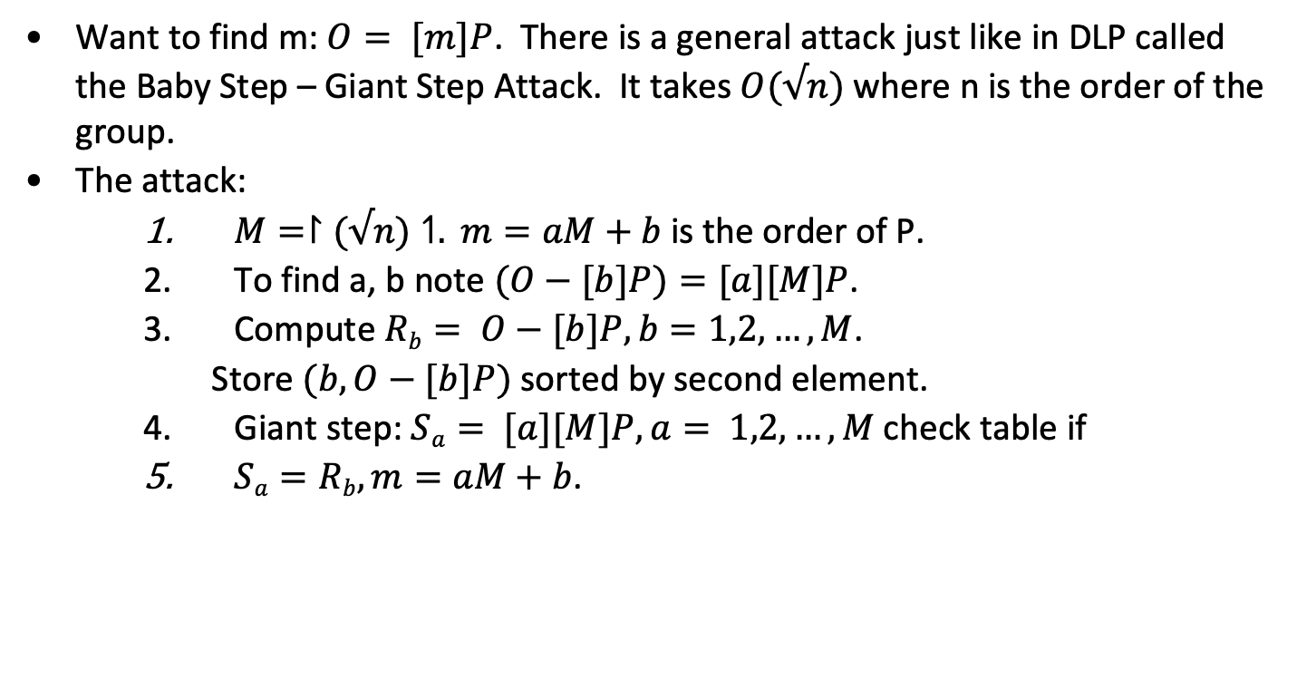
Baby step, giant step
Want to find m: $O= [m]P$. There is a general attack just like in DLP called the Baby Step – Giant Step Attack. It takes $O(√n)$ where n is the order of the group.
The attack:
$M=↾(√n)↿. m=aM+b$is the order of P.
To find a, b note $(O−[b]P)=[a][M]P$.
Compute $Rb= O−[b]P, b=1,2,…,M$.
Store $(b, O−[b]P)$sorted by second element.
Giant step: $Sa= [a][M]P, a= 1,2,…,M$check table if
$Sa=Rb, m=aM+b$.

Slide 34
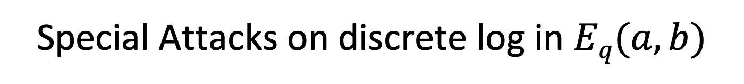
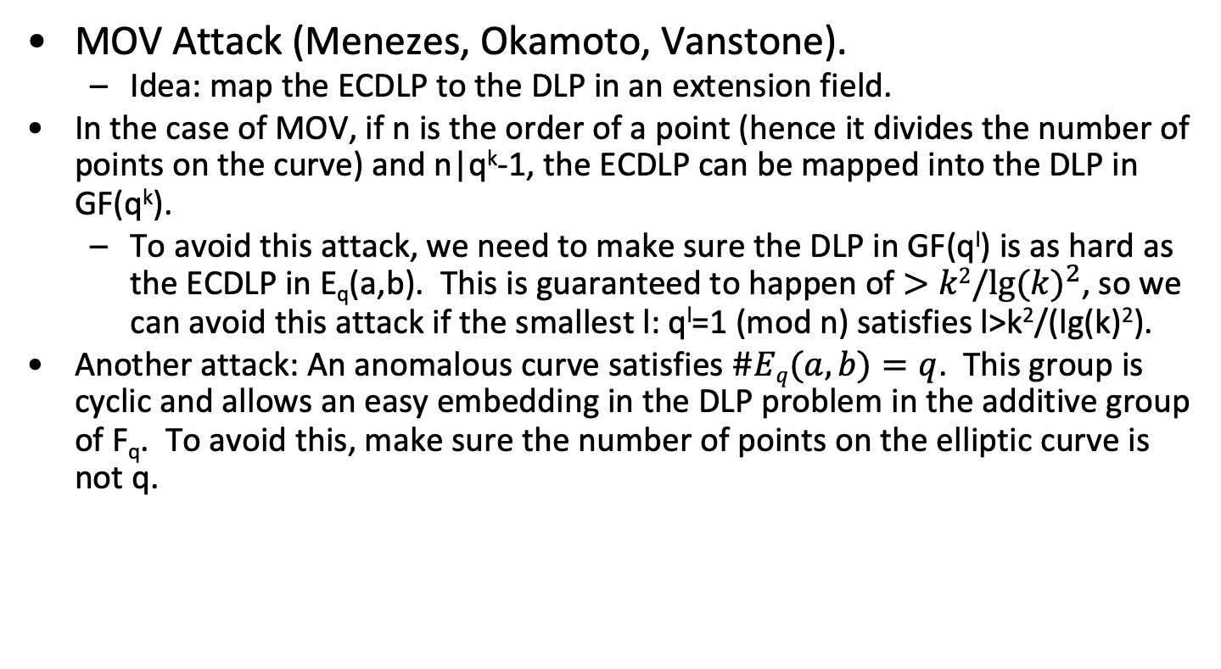
Special Attacks on discrete log in $Eq(a,b)$
MOV Attack (Menezes, Okamoto, Vanstone).
Idea: map the ECDLP to the DLP in an extension field.
In the case of MOV, if n is the order of a point (hence it divides the number of points on the curve) and n|q^{k}-1, the ECDLP can be mapped into the DLP in GF(q^{k}).
To avoid this attack, we need to make sure the DLP in GF(q^{l}) is as hard as the ECDLP in E_{q}(a,b). This is guaranteed to happen of $>k2/{lg⁡(k)}^{2}$, so we can avoid this attack if the smallest l: q^{l}=1 (mod n) satisfies l>k²/(lg(k)²).
Another attack: An anomalous curve satisfies $\#Eq(a,b)=q$. This group is cyclic and allows an easy embedding in the DLP problem in the additive group of F_{q}. To avoid this, make sure the number of points on the elliptic curve is not q.

Slide 35
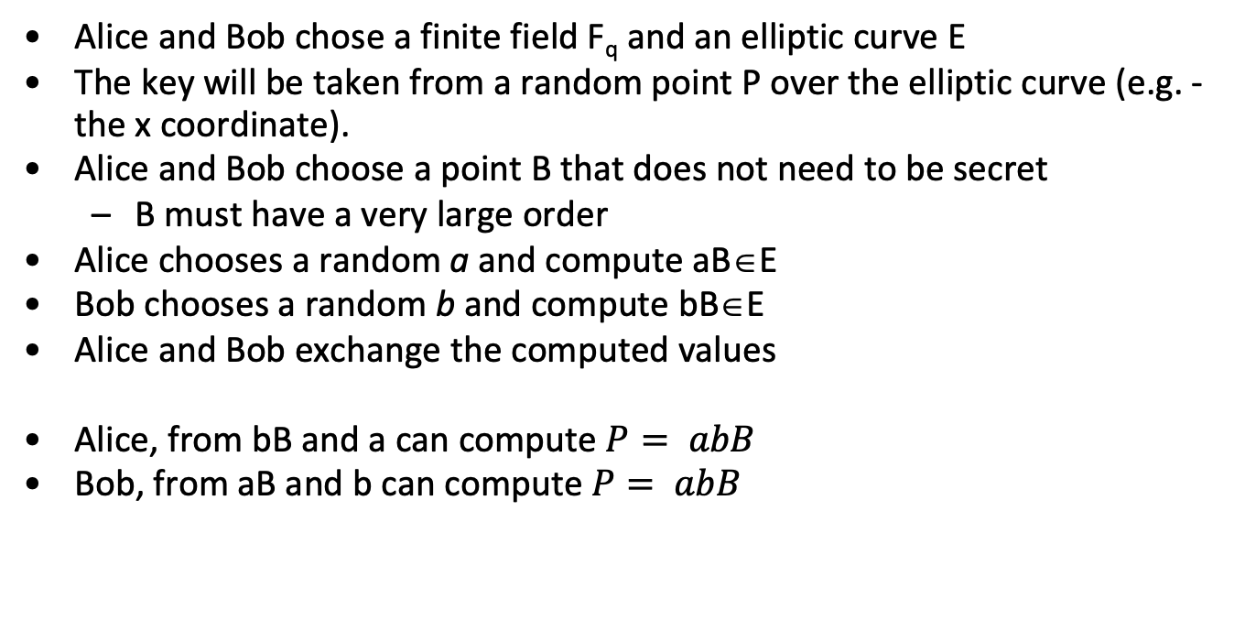
Diffie Hellman over ECC
Alice and Bob chose a finite field F_{q} and an elliptic curve E
The key will be taken from a random point P over the elliptic curve (e.g. - the x coordinate).
Alice and Bob choose a point B that does not need to be secret
B must have a very large order
Alice chooses a random a and compute aB∈E
Bob chooses a random b and compute bB∈E
Alice and Bob exchange the computed values
Alice, from bB and a can compute $P= abB$
Bob, from aB and b can compute $P= abB$

Slide 36
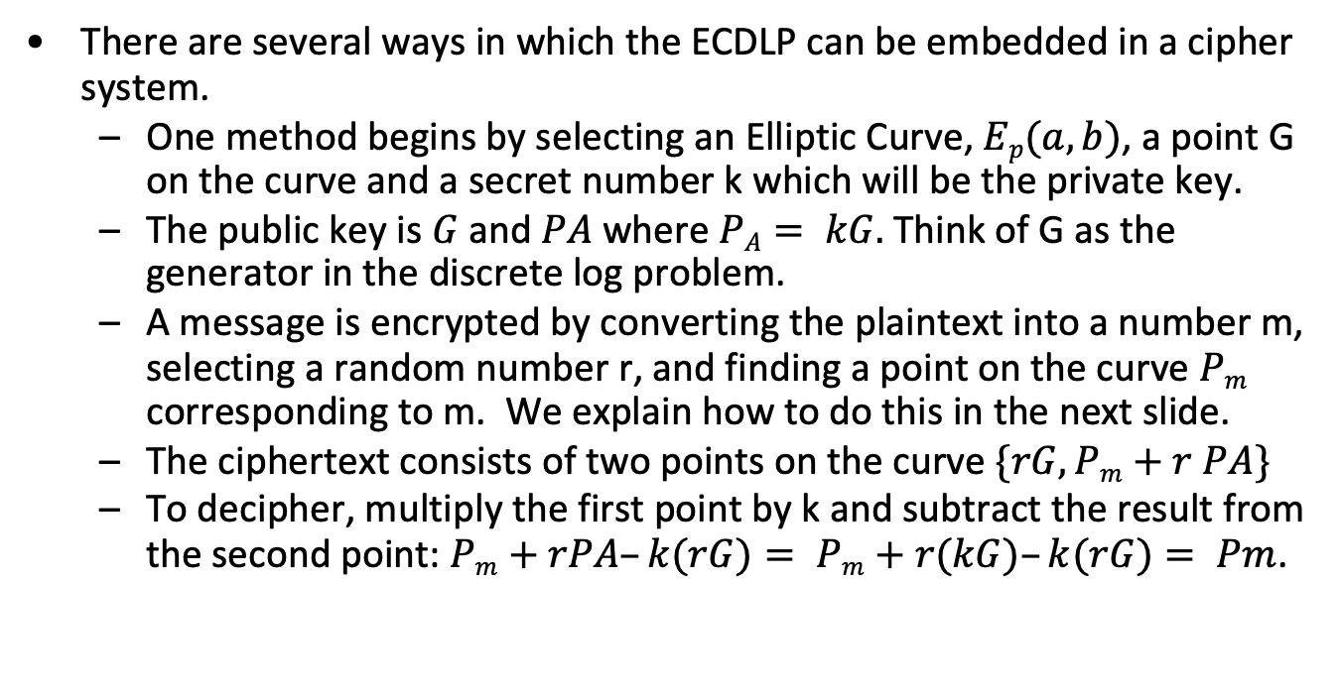
Elliptic curve El Gamal
There are several ways in which the ECDLP can be embedded in a cipher system.
One method begins by selecting an Elliptic Curve, $Ep(a,b)$, a point G on the curve and a secret number k which will be the private key.
The public key is $G$ and$PA$where $PA= kG.$Think of G as the generator in the discrete log problem.
A message is encrypted by converting the plaintext into a number m, selecting a random number r, and finding a point on the curve $Pm$ corresponding to m. We explain how to do this in the next slide.
The ciphertext consists of two points on the curve $\{rG, Pm+r PA\}$
To decipher, multiply the first point by k and subtract the result from the second point:$Pm+rPA–k(rG)= Pm+r(kG)–k(rG)= Pm$.

Slide 37
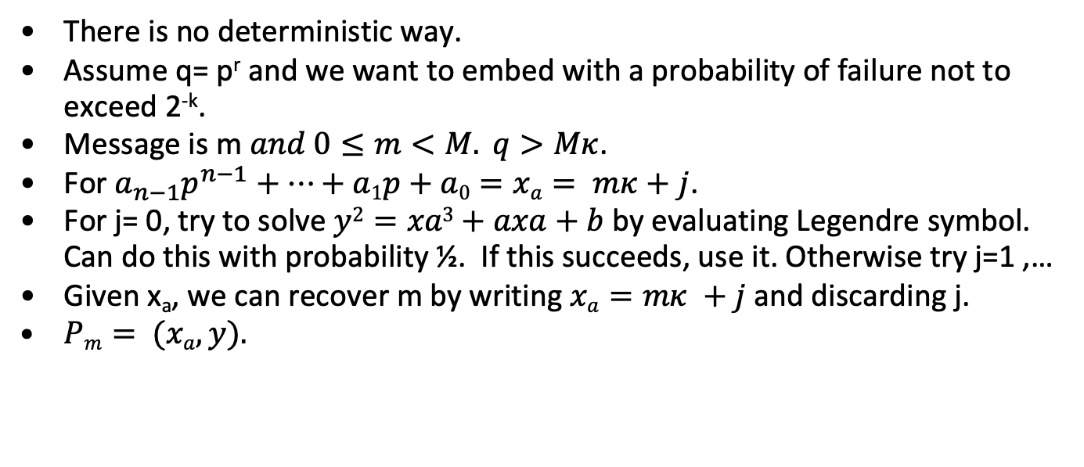
Embedding m in E_{q}(a,b)
There is no deterministic way.
Assume q= p^{r} and we want to embed with a probability of failure not to exceed 2^{-k}.
Message is m $and 0≤m<M. q>Mκ$.
For $a_{n−1}p^{n−1}+…+a1p+a0=xa= mκ+j$.
For j= 0, try to solve $y2=xa3+axa+b$by evaluating Legendre symbol. Can do this with probability ½. If this succeeds, use it. Otherwise try j=1 ,…
Given x_{a}, we can recover m by writing $xa=mκ +j$and discarding j.
$Pm= (xa, y).$

Slide 38
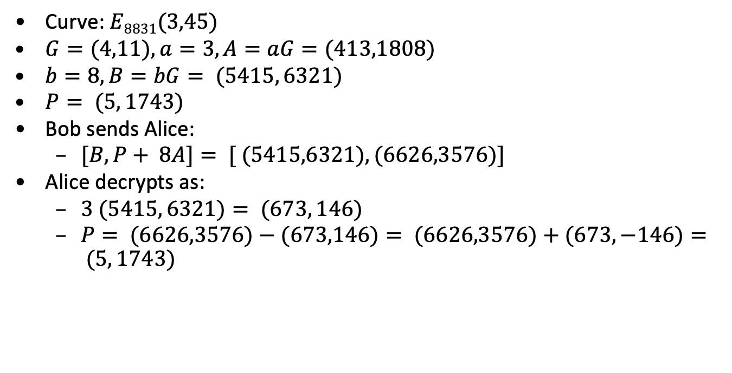
Putting it all together: EC El Gamal
Curve: $E8831(3,45)$
$G=(4,11),a=3, A=aG=(413,1808)$
$b=8, B=bG= (5415, 6321)$
$P= (5, 1743)$
Bob sends Alice:
$[B, P+ 8A]= [ (5415,6321), (6626,3576)]$
Alice decrypts as:
$3 (5415, 6321)= (673, 146)$
$P= (6626,3576)−(673,146)= (6626,3576)+(673,−146)= (5, 1743)$

Slide 39
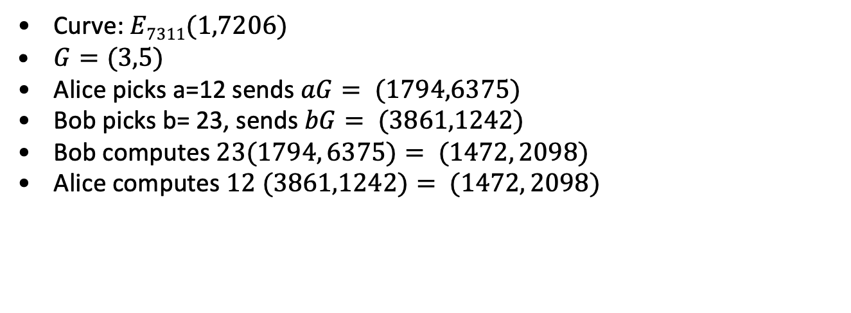
Putting it all together: ECDH
Curve:$E7311(1,7206)$
$G=(3,5)$
Alice picks a=12 sends $aG= (1794,6375)$
Bob picks b= 23, sends $bG= (3861,1242)$
Bob computes $23(1794, 6375)= (1472, 2098)$
Alice computes $12 (3861,1242)= (1472, 2098)$

Slide 40
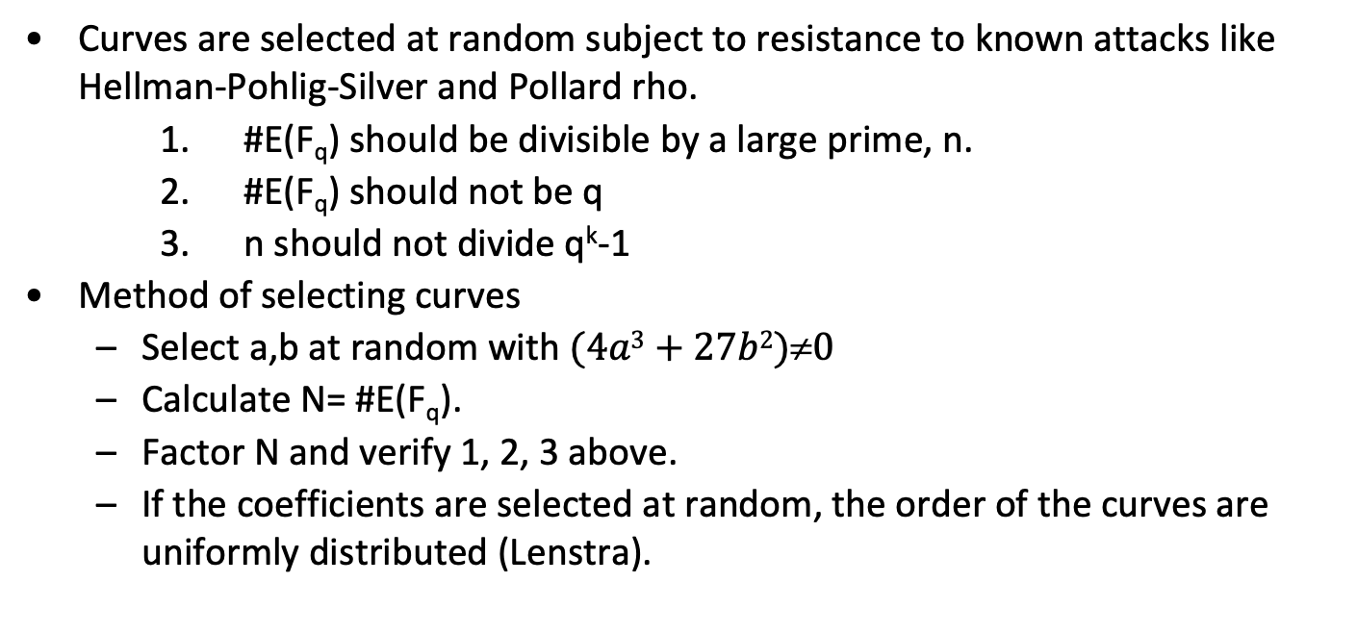
Picking Curves
Curves are selected at random subject to resistance to known attacks like Hellman-Pohlig-Silver and Pollard rho.
#E(F_{q}) should be divisible by a large prime, n.
#E(F_{q}) should not be q
n should not divide q^{k}-1
Method of selecting curves
Select a,b at random with $(4a3+27b2)0$
Calculate N= #E(F_{q}).
Factor N and verify 1, 2, 3 above.
If the coefficients are selected at random, the order of the curves are uniformly distributed (Lenstra).

Slide 41
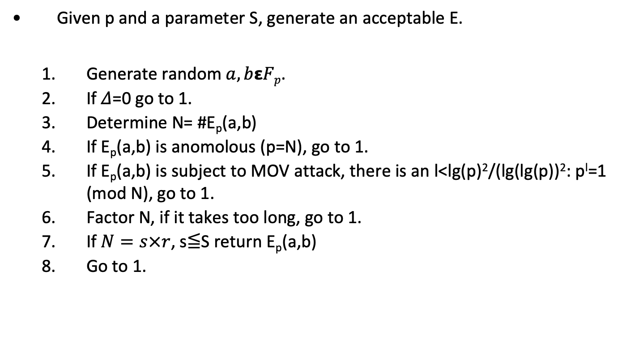
Curve selection
Given p and a parameter S, generate an acceptable E.
Generate random $a,bεFp$.
If 𝛥=0 go to 1.
Determine N= #E_{p}(a,b)
If E_{p}(a,b) is anomolous (p=N), go to 1.
If E_{p}(a,b) is subject to MOV attack, there is an l<lg(p)²/(lg(lg(p))²: p^{l}=1 (mod N), go to 1.
Factor N, if it takes too long, go to 1.
If $N=s×r$, s≦S return E_{p}(a,b)
Go to 1.

Slide 42
ECC Point Operation Costs and modular operations
Parameters
I= inverse cost in GF(p).
S= square cost GF(p).
M= multiply cost GF(p)
Op | Cost | Modular Op | Cost
2P | I+2S+2M | Add, Sub | O(lg(n))
P+Q | I + S+ 2M | Multiply | O(lg(n)²)
2P+Q | 2I + 2S + 2M | Invert | O(lg(n)²)
P+Q, P-Q | I+2S+4M | Exp | O(lg(n)³)

Slide 43
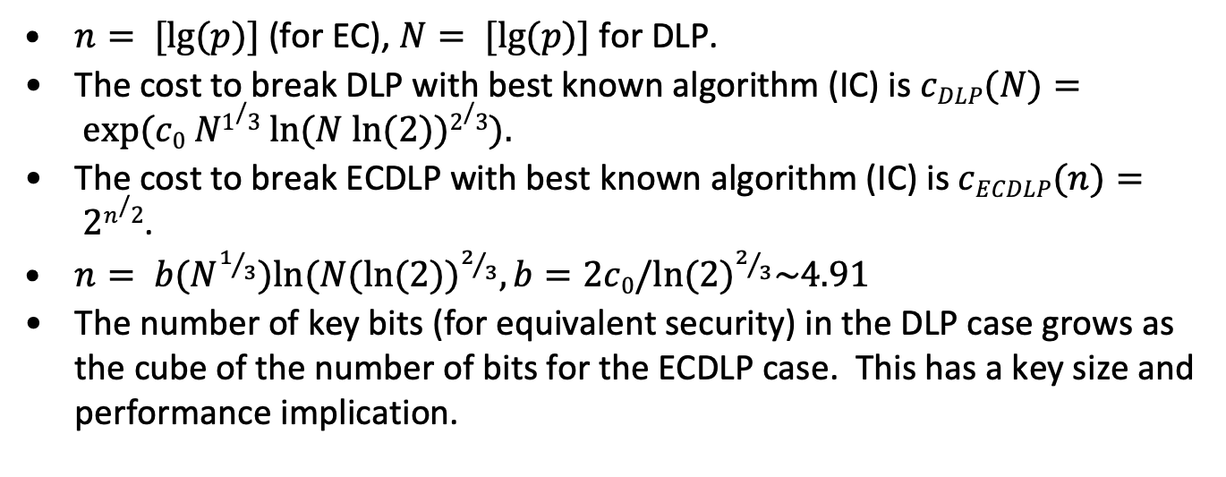
ECC vs RSA performance analysis
$n= [lg⁡(p)]$(for EC), $N= [lg⁡(p)]$for DLP.
The cost to break DLP with best known algorithm (IC) is $cDLP(N)= exp⁡(c0 N1/3 ln⁡(N ln⁡(2))2/3).$
The cost to break ECDLP with best known algorithm (IC) is $cECDLP(n)= 2n/2$.
$n= b(N^{1/3}){ln⁡(N(ln⁡(2))}^{2/3}, b=2c0/{ln⁡(2)}^{2/3}\sim 4.91$
The number of key bits (for equivalent security) in the DLP case grows as the cube of the number of bits for the ECDLP case. This has a key size and performance implication.

Slide 44
Pollard Rho Method for ECC vs. Factoring by Number Field Sieve
Key size MIPS-Years
150 bits 3.8x10¹⁰
205 bits 7.1x10¹⁸
234 bits 1.6x10²⁸
Elliptic Curve Logarithms Using Pollard Rho Method
Key size MIPS-Years
512 bits 3x10⁴
768 bits 2x10⁸
1024 bits 3x10¹¹
1280 bits 3x10¹⁴
1536 bits 3x10¹⁶
2048 bits 3x10²⁰
Integer Factoring Using Number Field Sieve
This slide came from someone else

Slide 45
Observations on ECC
Asymmetry between encryption and decryption is reduced (4:1)
NIST recommendations for key size to provide “equivalent” security (bits in key).
ECC | RSA | AES
163 | 1024
256 | 3072 | 128
384 | 7680 | 192
521 | 15360 | 256

Slide 46
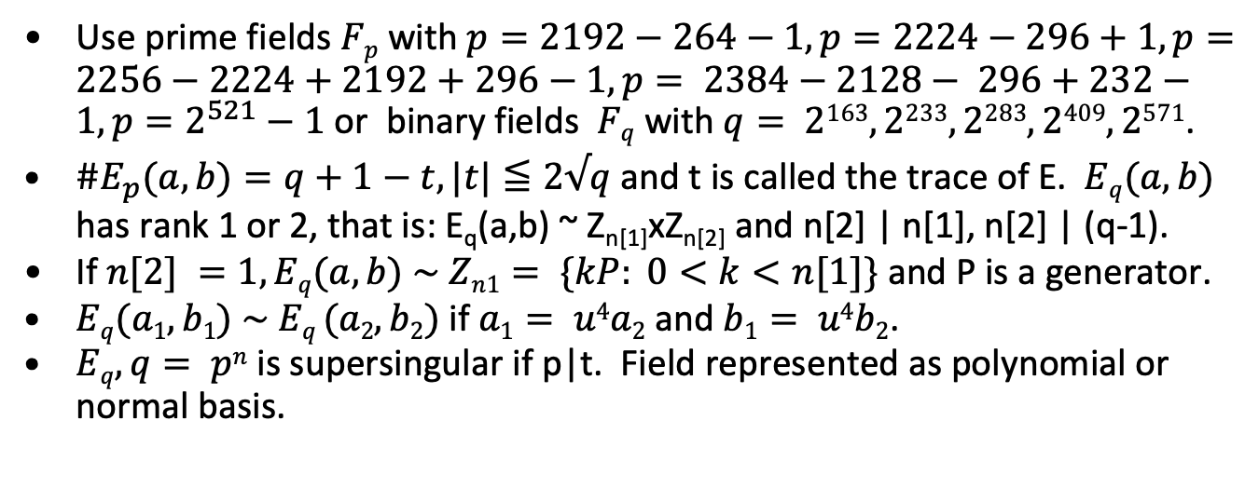
NIST Curves
Use prime fields $Fp$ with $p=2192−264−1, p=2224−296+1, p=2256−2224+2192+296−1, p= 2384−2128− 296+232−1, p=2^{521}−1$ or binary fields $Fq$ with $q= 2163, 2233, 2283, 2409, 2571$.
$\#E_{p}(a,b)=q+1−t, |t|≦2√q$and t is called the trace of E. $Eq(a,b)$ has rank 1 or 2, that is: E_{q}(a,b) ~ Z_{n[1]}xZ_{n[2]} and n[2] | n[1], n[2] | (q-1).
If $n[2] =1, Eq(a,b) \sim Zn1= \{kP: 0<k<n[1]\}$ and P is a generator.
$Eq(a1, b1) \sim Eq (a2, b2)$if $a1= u4a2$ and $b1= u4b2$.
$Eq, q= pn$is supersingular if p|t. Field represented as polynomial or normal basis.

Slide 47
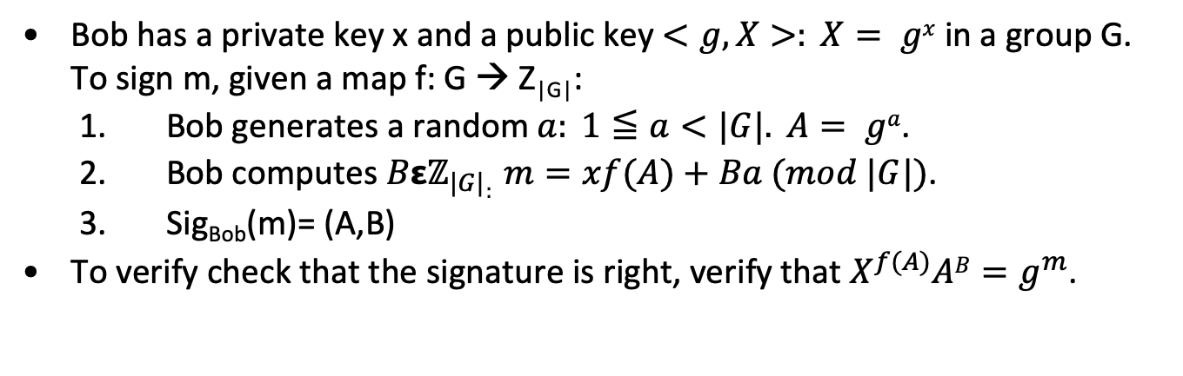
El Gamal Signature
Bob has a private key x and a public key $<g,X>: X= gx$in a group G. To sign m, given a map f: G → Z_{|G|}:
Bob generates a random $a: 1≦a<|G|. A= ga$.
Bob computes $Bεℤ_{|G|}: m=xf(A)+Ba (mod |G|)$.
Sig_{Bob}(m)= (A,B)
To verify check that the signature is right, verify that $X^{f(A)}AB=g^{m}$.

Slide 48
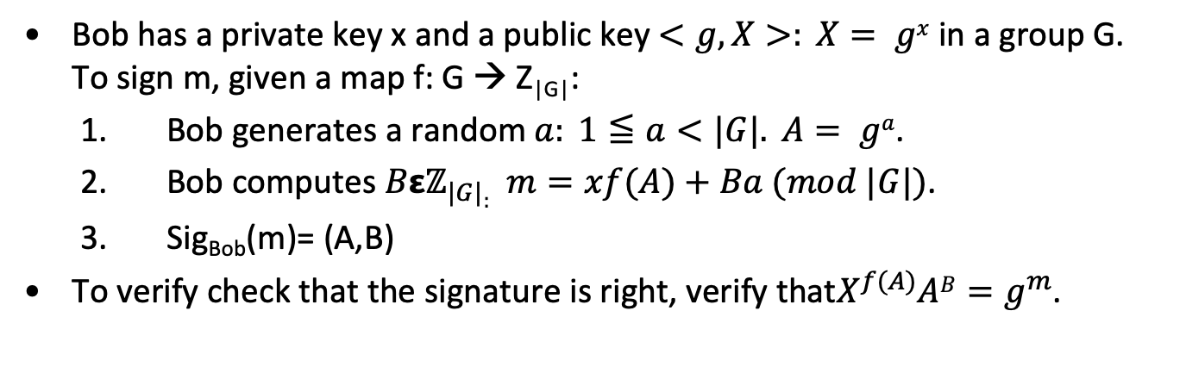
EC El Gamal Signature
Bob has a private key x and a public key $<g,X>: X= gx$in a group G. To sign m, given a map f: G → Z_{|G|}:
Bob generates a random $a: 1≦a<|G|. A= ga$.
Bob computes $Bεℤ_{|G|}: m=xf(A)+Ba (mod |G|)$.
Sig_{Bob}(m)= (A,B)
To verify check that the signature is right, verify that$X^{f(A)}AB=g^{m}$.

Slide 49
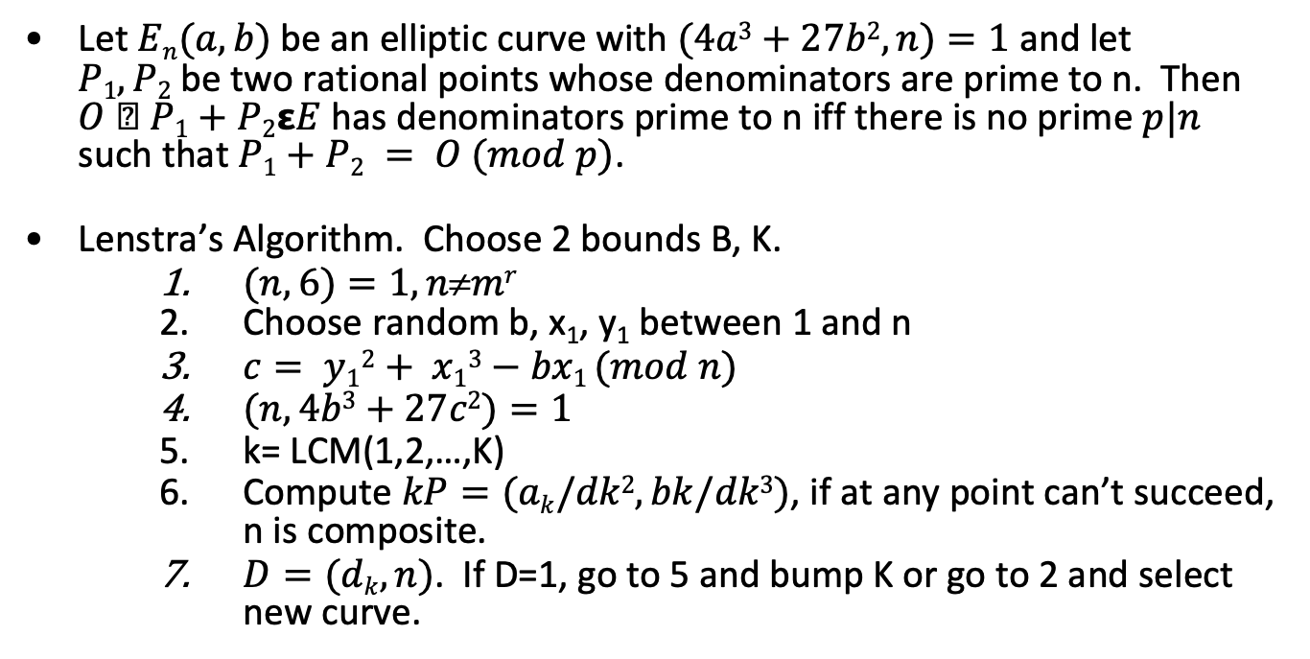
Factoring using Elliptic Curves
Let $En(a,b)$be an elliptic curve with $(4a3+27b2, n)=1$and let $P1, P2$be two rational points whose denominators are prime to n. Then $O  P1+P2εE$ has denominators prime to n iff there is no prime $p|n$ such that $P1+P2 = O (mod p)$.
Lenstra’s Algorithm. Choose 2 bounds B, K.
$(n,6)=1, nmr$
Choose random b, x₁, y₁ between 1 and n
$c= y12+ x13−bx1 (mod n)$
$(n, 4b3+27c2)=1$
k= LCM(1,2,…,K)
Compute $kP=(ak/dk2,bk/dk3)$, if at any point can’t succeed, n is composite.
$D=(dk,n)$. If D=1, go to 5 and bump K or go to 2 and select new curve.

Slide 50
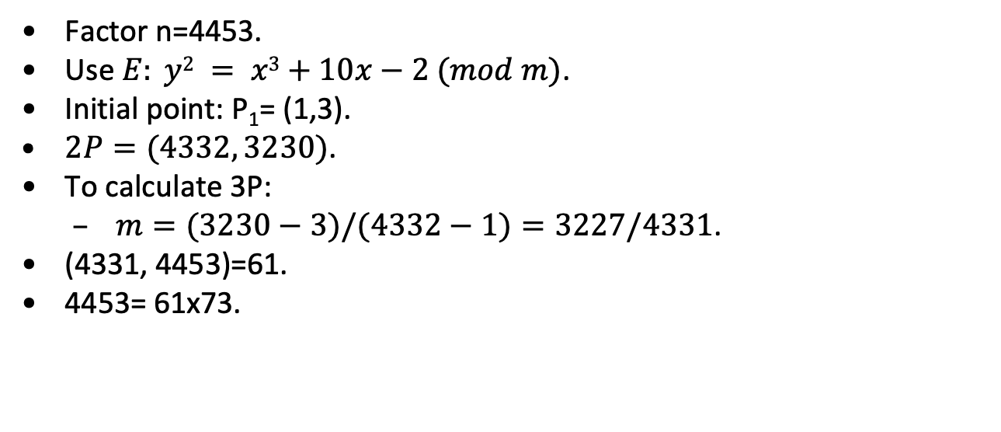
Factoring using elliptic curves - example
Factor n=4453.
Use $E: y2 = x3+10x−2 (mod m)$.
Initial point: P₁= (1,3).
$2P=(4332, 3230)$.
To calculate 3P:
$m=(3230−3)/(4332−1)=3227/4331$.
(4331, 4453)=61.
4453= 61x73.

Slide 51
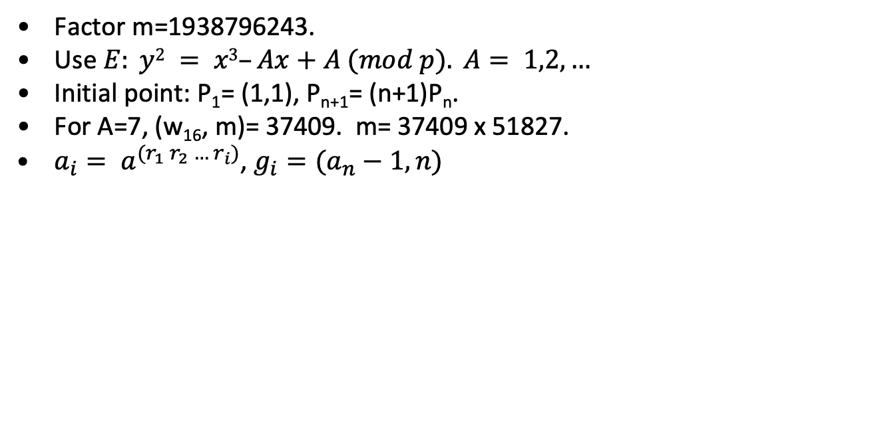
Factoring using elliptic curves - example
Factor m=1938796243.
Use $E: y2 = x3–Ax+A (mod p). A= 1,2,…$
Initial point: P₁= (1,1), P_{n+1}= (n+1)P_{n}.
For A=7, (w₁₆, m)= 37409. m= 37409 x 51827.
$a_{i}= a^{(r_{1} r_{2} … r_{i})}$, $g_{i}=(a_{n}−1,n)$

Slide 52
Divisors
D= ∑_{j} a_{j}[P_{j}], a_{j} 𝝴 Z
deg(D)= ∑_{j} a_{j}
sum(D)= ∑_{j} a_{j}P_{j}
sum: Div⁰(E) → E(K).
f= u_{P}^{r} g: ord_{P}(f)=r, div(f)= S_{P𝝴E(K)} ord_{P}(f) [P]
Div⁰(E)/(principal divisors) is isomorphic to E(K)
Let E be an elliptic curve and f a function on E that is ≠0 then
f has only finitely many poles and zeros
deg(div(f))=0
If f has no poles or zeros it is constant

Slide 53
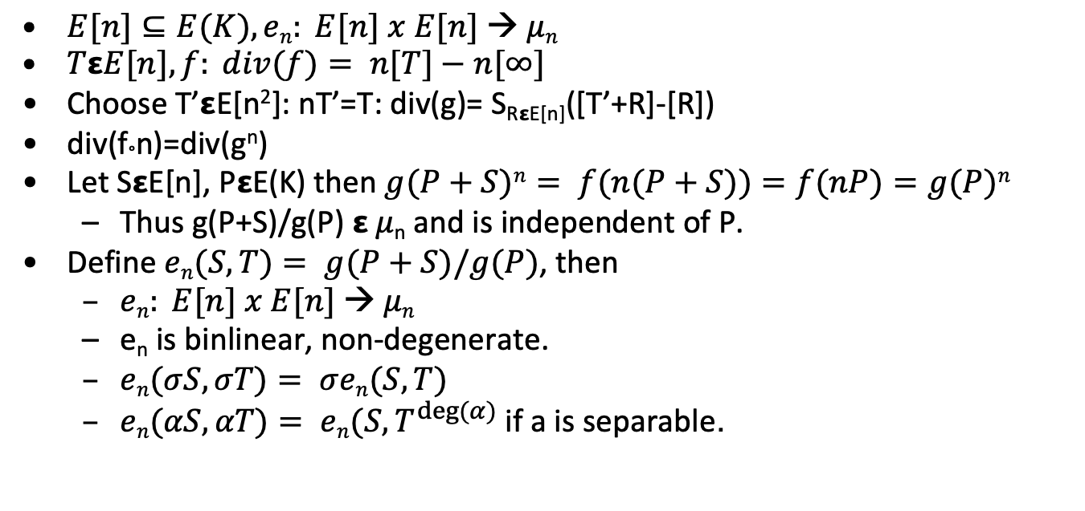
Pairings
Choose T’𝝴E[n²]: nT’=T: div(g)= S_{R𝝴E[n]}([T’+R]-[R])
div(f°n)=div(g^{n})
Let S𝝴E[n], P𝝴E(K) then $g(P+S)n= f(n(P+S))=f(nP)=g(P)n$
Thus g(P+S)/g(P) 𝝴 𝜇_{n} and is independent of P.
Define $en(S,T)= g(P+S)/g(P)$, then
$en: E[n] x E[n] → μn$
e_{n} is binlinear, non-degenerate.
if a is separable.

Slide 54
End

Slide 55
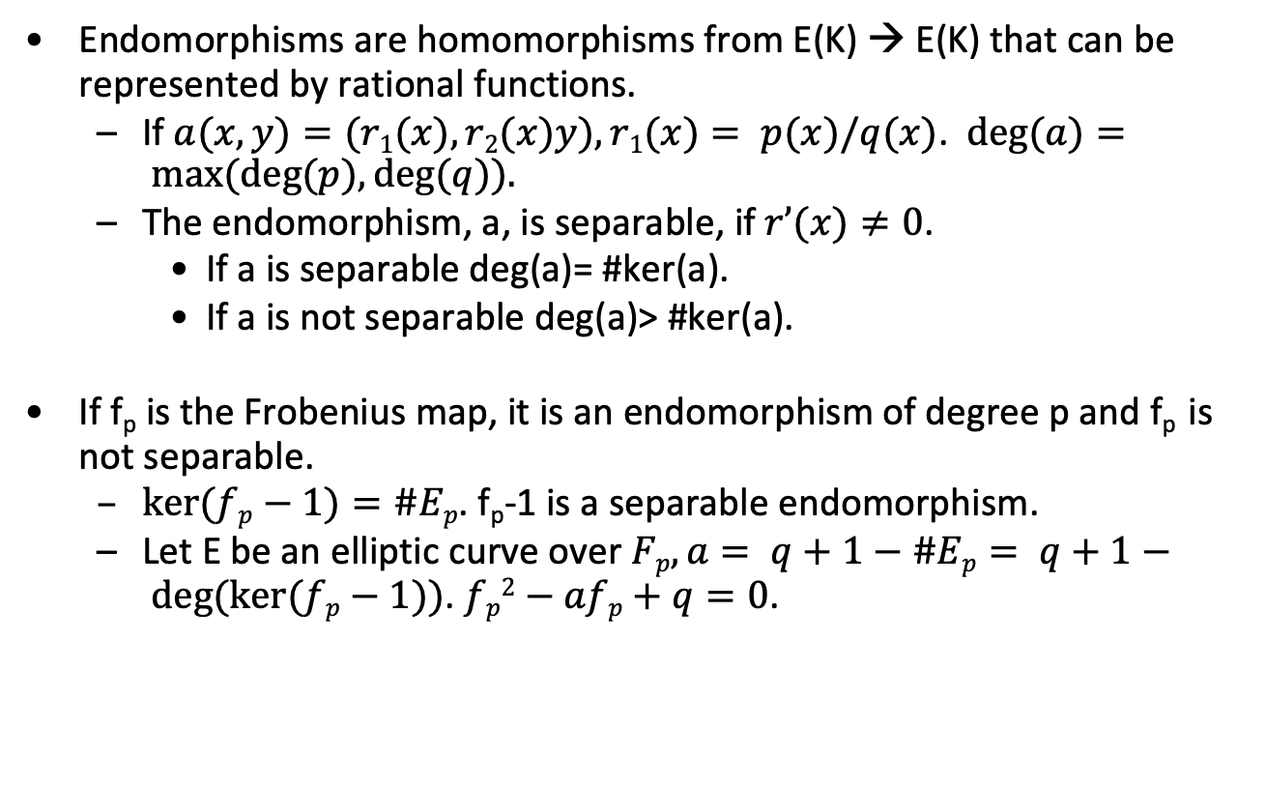
Endomorphisms
Endomorphisms are homomorphisms from E(K) → E(K) that can be represented by rational functions.
If $a(x,y)=(r1(x), r2(x)y), r1(x)= p(x)/q(x)$. $deg⁡(a)= max⁡(deg⁡(p), deg⁡(q)).$
The endomorphism, a, is separable, if $r’(x)≠0$.
If a is separable deg(a)= #ker(a).
If a is not separable deg(a)> #ker(a).
If f_{p} is the Frobenius map, it is an endomorphism of degree p and f_{p} is not separable.
$ker⁡(fp−1)=\#Ep$. f_{p}-1 is a separable endomorphism.
Let E be an elliptic curve over $Fp, a= q+1−\#Ep= q+1− deg⁡(ker⁡(fp−1))$. $fp2−afp+q=0$.

Slide 56
Shanks and Menstre
Input: E_{q}(a,b), #E_{q}(a,b)=q+1-t, |t|≦4<q.
Output: Bound on t. O(q^{1/4}+e).
Pick random point P on E_{q}(a,b), |P|>4<q.
Q=[q+1]P
Q₁= Q+ floor[2q]P
t’= t+ floor[2q], note 0≦t’ ≦4q
m= ceiling(2q^{1/4})
Baby step: [j]P
Giant step: Q₁-[i][m]P
t’= im+j, i,j<m. This bounds #E_{q}(a,b).
Menstre: either a curve or its twist has a point with order >4q

Slide 57
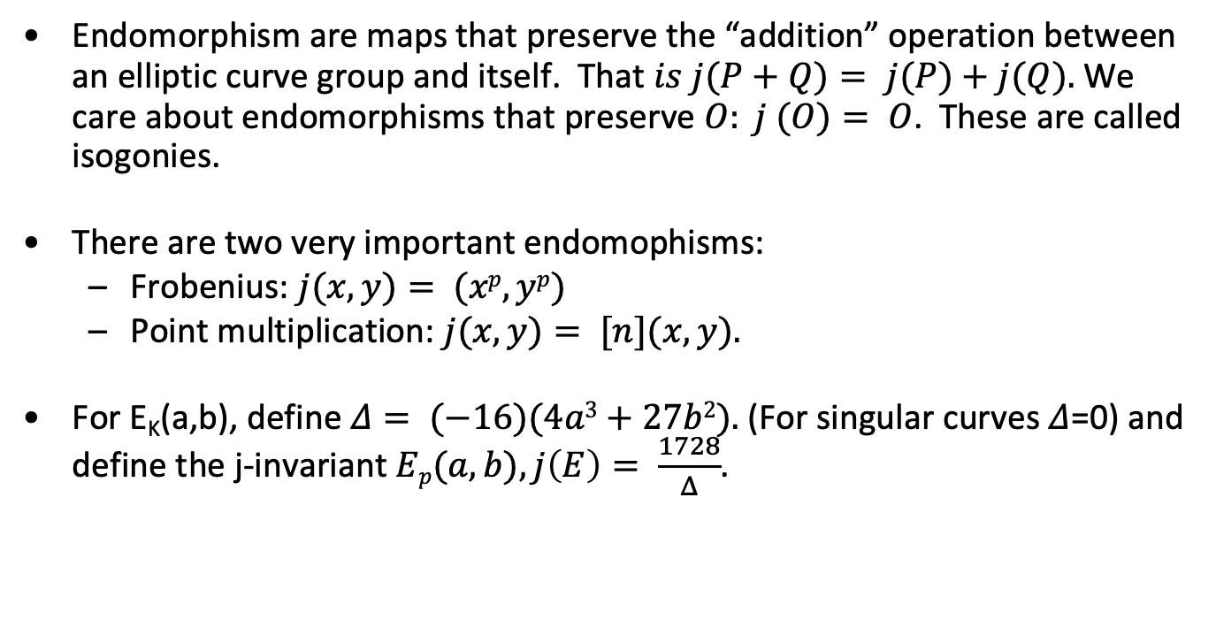
Endomorphisms continued
Endomorphism are maps that preserve the “addition” operation between an elliptic curve group and itself. That $is j(P+Q)= j(P)+j(Q).$We care about endomorphisms that preserve $O: j (O)= O$. These are called isogonies.
There are two very important endomophisms:
Frobenius: $j(x,y)= (xp, yp)$
Point multiplication: $j(x,y)= [n](x,y).$
For E_{K}(a,b), define $Δ= (−16)(4a3+27b2).$(For singular curves 𝛥=0) and define the j-invariant $Ep(a,b), j\left(E\right)= \frac{1728}{Δ}$.

Slide 58
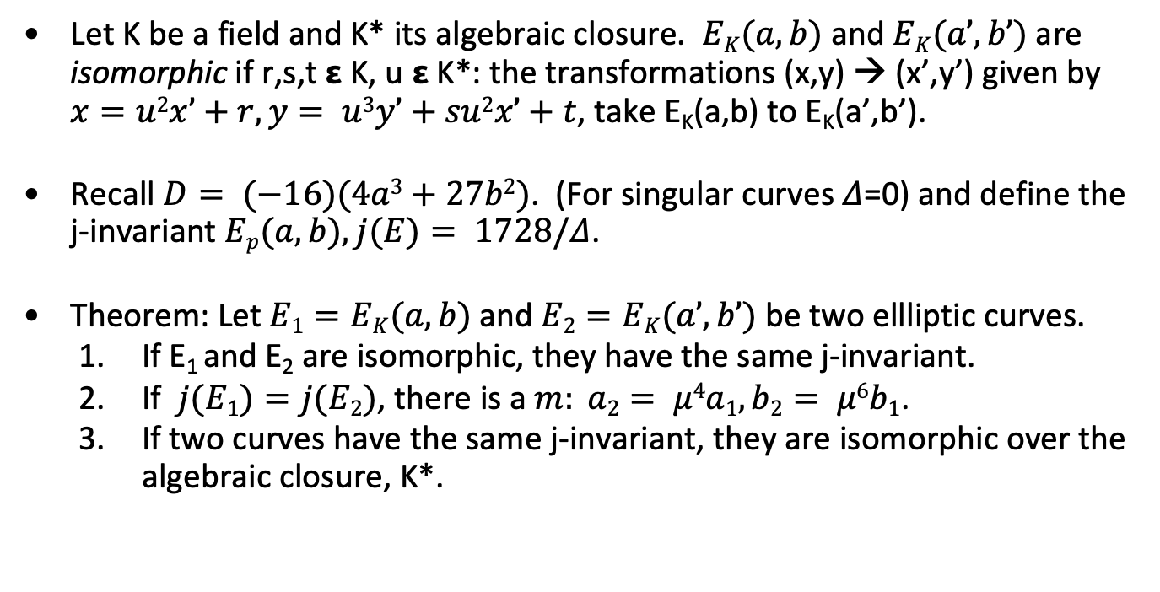
Isomorphic Curves and the j-invariant
Let K be a field and K* its algebraic closure. $EK(a,b)$ and $EK(a’,b’)$are isomorphic if r,s,t 𝝴 K, u 𝝴 K*: the transformations (x,y) → (x’,y’) given by $x=u2x’+r, y= u3y’+su2x’+t$, take E_{K}(a,b) to E_{K}(a’,b’).
Recall $D= (−16)(4a3+27b2)$. (For singular curves 𝛥=0) and define the j-invariant $Ep(a,b), j(E)= 1728/Δ$.
Theorem: Let $E1=EK(a,b)$and $E2=EK(a’,b’)$ be two ellliptic curves.
If E₁ and E₂ are isomorphic, they have the same j-invariant.
If $j(E1)=j(E2)$, there is a $m: a2= μ4a1, b2= μ6b1$.
If two curves have the same j-invariant, they are isomorphic over the algebraic closure, K*.

Slide 59
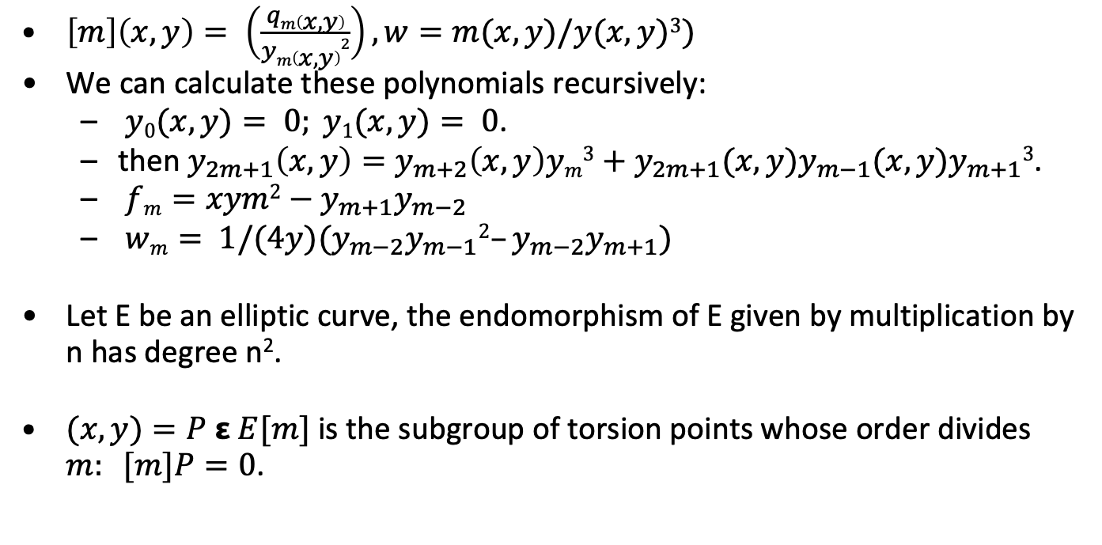
The Division Polynomials
$\left[m\right]\left(x,y\right)= \left(\frac{qm\left(x,y\right)}{ym\left(x,y\right)2}\right), w=m(x,y)/y(x,y)3)$
We can calculate these polynomials recursively:
$y0(x,y)= 0; y1(x,y)= 0$.
then $y_{2m+1}\left(x,y\right)=y_{m+2}\left(x,y\right)ym3+y_{2m+1}(x,y)y_{m−1}(x,y)y_{m+1}3$.
$fm=xym2−y_{m+1}y_{m−2}$
$wm= 1/(4y)(y_{m−2}y_{m−1}2–y_{m−2}y_{m+1})$
Let E be an elliptic curve, the endomorphism of E given by multiplication by n has degree n².
$(x,y)=P ε E[m]$is the subgroup of torsion points whose order divides $m: [m]P=0$.

Slide 60

Preliminary DSA
Bob has a private key x and a public key $<g,X>: X= gx$ in a group G. To sign m, given a map $f: G → ℤ_{|G|}$:
Bob generates a random $a: 1≦a<|G|. A= ga$.
Bob computes $Bεℤ_{|G|}: m= −xf(A)+Ba (mod |G|).$
$SigBob(m)= (A,B)$
To verify compute $u= mB^{−1}(mod |G|), v=f(A) B^{−1}(mod |G|)$ and $w=guXv$. Verify that $w=A$.

Slide 61

ECDSA
$D=(q, a,b,P,n,h). nh= \#Eq(a,b)$. Private key$d$, message $m$.
Signature $(r,s)$
Select $kε[1,n−1]$
Compute $kP=(x1, y1)$. Convert x₁ to integer x₁.
Compute $r= x1 (mod n)$. If r=0 goto 1.
Compute $e=H(m)$.
$s= k−1(e+dr) (mod n)$. If s=0, goto 1.
Verify
Check $r,s ∈[1,n−1]$. Compute $e=H(m)$.
Compute $w= s^{−1}(mod n). u1= ew (mod n)$. $u2= rw (mod n)$.
Compute $X= u1 P+ u2 Q$. If $X= O$, reject.
Convert x₁ of X to integer x₁. Compute $v= x1 (mod n)$.
If (v=r) accept signature.

Slide 62

ECIES
Input $D=(q, a, b, P, n, h)$, public key $Q$, plaintext $m$.
ENC, MAC, DEC are standard “symmetric key” functions. KDF is key derivation function (also standard).
Pick $kε[1, n−1]$.
Compute $R= kP, Z=hkQ$. If Z=O, go to 1.
$(k[1], k[2]) = KDF(xZ, R)$.
$c= ENCk1(m), t= MACk[2](c)$.
return (R, c, t)

